Slide 1


Day:1 AI/ML for Beginners
Fundamentals of AI and ML with a hands-on approach using Python

Slide 2



Introduction to AI & Machine Learning Fundamentals
Data, Preprocessing, and Exploratory Data Analysis (EDA)
Python for Machine Learning
Regression – Simple Linear Regression
AGENDA

Slide 3
Key Terms to Watch
Artificial Intelligence (AI): The broad capability of machines to imitate intelligent human behavior.
Features: The independent variables or "inputs" used to make a prediction (e.g., square footage of a house).
Labels (Target Variable): The "output" or what the model is trying to predict (e.g., the price of a house).
Supervised Learning: Training a model where the "answer key" (labels) is provided.
Unsupervised Learning: Training a model on data without labels to find hidden patterns or groups.
Regression: A type of ML problem used for predicting continuous numerical values (e.g., stock prices).
Classification: A type of ML problem used for predicting categories (e.g., "Dog" vs. "Not-Dog").
Overfitting: When a model learns the training data too well, including the noise, and performs poorly on new data (Note: This is introduced in Module 6 but is helpful to mention early).
Training/Test Split: Dividing data into two sets—one to teach the model and one to see how well it learned
Notes:
Content:
Not every GenAI idea is worth pursuing immediately. Use a 3-factor model:
🔢 1. ROI (Return on Investment)
Time saved per sprint
Reduction in delivery delays or defects
Value of insight gained
🧩 2. Complexity
Data requirements and integration effort
Workflow disruption and training needs
Tool/vendor dependency
✅ 3. Feasibility
Team maturity and skills
Existing tool compatibility
Governance and AI policy readiness
Use This Matrix:
Quick Wins – High ROI, low complexity (start here)
Strategic Bets – High ROI, high complexity (plan for scale)
Deprioritized – Low ROI, high complexity (low leverage)
Example Exercise:
Score the "automated release note generator":
ROI = High
Complexity = Medium
Feasibility = High
→ Prioritize for pilot

Slide 4




What is Machine Learning?
Machine learning is a subfield of Artificial Intelligence, which is broadly defined as the capability of a machine to imitate intelligent human behavior
Machine learning allows businesses to enable the data to teach the system how to solve the problem at hand with machine learning algorithms—and how to get better over time
MIT
Google
Machine learning (ML) is the process of using mathematical models of data to help a computer learn without direct instruction
Machine learning is based on algorithms that can learn from data without relying on rules-based programming. It is considered as the sub-set of AI
Microsoft
Mckinsey
Notes:
Content:
Not every GenAI idea is worth pursuing immediately. Use a 3-factor model:
🔢 1. ROI (Return on Investment)
Time saved per sprint
Reduction in delivery delays or defects
Value of insight gained
🧩 2. Complexity
Data requirements and integration effort
Workflow disruption and training needs
Tool/vendor dependency
✅ 3. Feasibility
Team maturity and skills
Existing tool compatibility
Governance and AI policy readiness
Use This Matrix:
Quick Wins – High ROI, low complexity (start here)
Strategic Bets – High ROI, high complexity (plan for scale)
Deprioritized – Low ROI, high complexity (low leverage)
Example Exercise:
Score the "automated release note generator":
ROI = High
Complexity = Medium
Feasibility = High
→ Prioritize for pilot

Slide 5





What is Machine Learning?
Subset of Computer Science & Artificial Intelligence
Focuses on use of data driven solutions
Imitates the way human learns
Gradually improves itself
Notes:
Content:
Not every GenAI idea is worth pursuing immediately. Use a 3-factor model:
🔢 1. ROI (Return on Investment)
Time saved per sprint
Reduction in delivery delays or defects
Value of insight gained
🧩 2. Complexity
Data requirements and integration effort
Workflow disruption and training needs
Tool/vendor dependency
✅ 3. Feasibility
Team maturity and skills
Existing tool compatibility
Governance and AI policy readiness
Use This Matrix:
Quick Wins – High ROI, low complexity (start here)
Strategic Bets – High ROI, high complexity (plan for scale)
Deprioritized – Low ROI, high complexity (low leverage)
Example Exercise:
Score the "automated release note generator":
ROI = High
Complexity = Medium
Feasibility = High
→ Prioritize for pilot

Slide 6
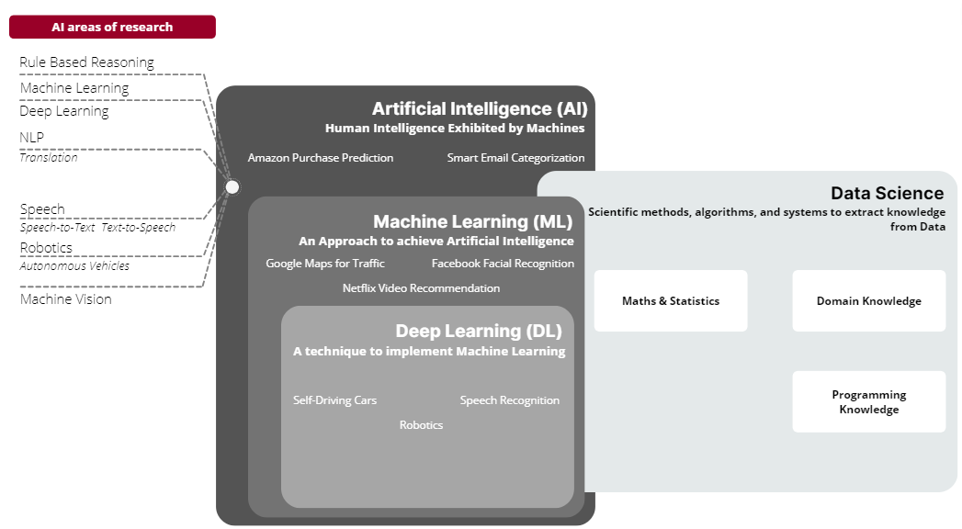
AI vs ML vs DS
Notes:
Content:
Not every GenAI idea is worth pursuing immediately. Use a 3-factor model:
🔢 1. ROI (Return on Investment)
Time saved per sprint
Reduction in delivery delays or defects
Value of insight gained
🧩 2. Complexity
Data requirements and integration effort
Workflow disruption and training needs
Tool/vendor dependency
✅ 3. Feasibility
Team maturity and skills
Existing tool compatibility
Governance and AI policy readiness
Use This Matrix:
Quick Wins – High ROI, low complexity (start here)
Strategic Bets – High ROI, high complexity (plan for scale)
Deprioritized – Low ROI, high complexity (low leverage)
Example Exercise:
Score the "automated release note generator":
ROI = High
Complexity = Medium
Feasibility = High
→ Prioritize for pilot

Slide 7
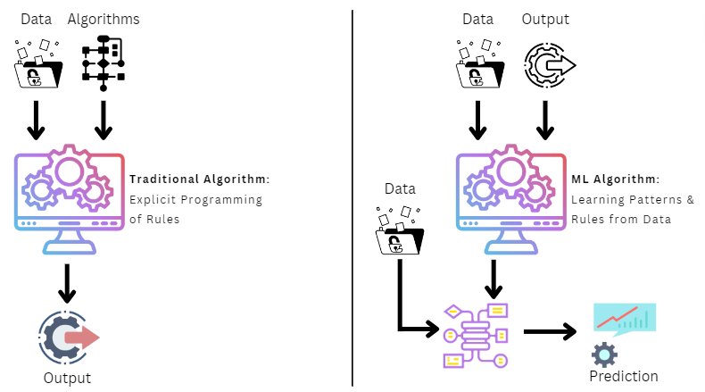
Traditional Systems vs Machine Learning Systems
Notes:
Content:
Not every GenAI idea is worth pursuing immediately. Use a 3-factor model:
🔢 1. ROI (Return on Investment)
Time saved per sprint
Reduction in delivery delays or defects
Value of insight gained
🧩 2. Complexity
Data requirements and integration effort
Workflow disruption and training needs
Tool/vendor dependency
✅ 3. Feasibility
Team maturity and skills
Existing tool compatibility
Governance and AI policy readiness
Use This Matrix:
Quick Wins – High ROI, low complexity (start here)
Strategic Bets – High ROI, high complexity (plan for scale)
Deprioritized – Low ROI, high complexity (low leverage)
Example Exercise:
Score the "automated release note generator":
ROI = High
Complexity = Medium
Feasibility = High
→ Prioritize for pilot

Slide 8
Learning Algorithms vs Models
Learning Algorithm
Data
Set of instructions that can learn pattern from Data
Applied to
Refined Data
Produces
Model
Approximation of the reality, built using a Learning Algorithm
Notes:
Content:
Not every GenAI idea is worth pursuing immediately. Use a 3-factor model:
🔢 1. ROI (Return on Investment)
Time saved per sprint
Reduction in delivery delays or defects
Value of insight gained
🧩 2. Complexity
Data requirements and integration effort
Workflow disruption and training needs
Tool/vendor dependency
✅ 3. Feasibility
Team maturity and skills
Existing tool compatibility
Governance and AI policy readiness
Use This Matrix:
Quick Wins – High ROI, low complexity (start here)
Strategic Bets – High ROI, high complexity (plan for scale)
Deprioritized – Low ROI, high complexity (low leverage)
Example Exercise:
Score the "automated release note generator":
ROI = High
Complexity = Medium
Feasibility = High
→ Prioritize for pilot

Slide 9
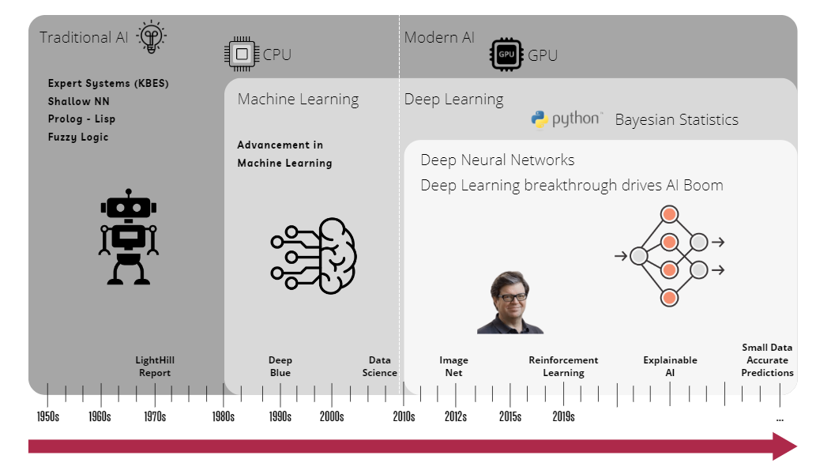
History of AI/ML System
Notes:
Content:
Not every GenAI idea is worth pursuing immediately. Use a 3-factor model:
🔢 1. ROI (Return on Investment)
Time saved per sprint
Reduction in delivery delays or defects
Value of insight gained
🧩 2. Complexity
Data requirements and integration effort
Workflow disruption and training needs
Tool/vendor dependency
✅ 3. Feasibility
Team maturity and skills
Existing tool compatibility
Governance and AI policy readiness
Use This Matrix:
Quick Wins – High ROI, low complexity (start here)
Strategic Bets – High ROI, high complexity (plan for scale)
Deprioritized – Low ROI, high complexity (low leverage)
Example Exercise:
Score the "automated release note generator":
ROI = High
Complexity = Medium
Feasibility = High
→ Prioritize for pilot

Slide 10
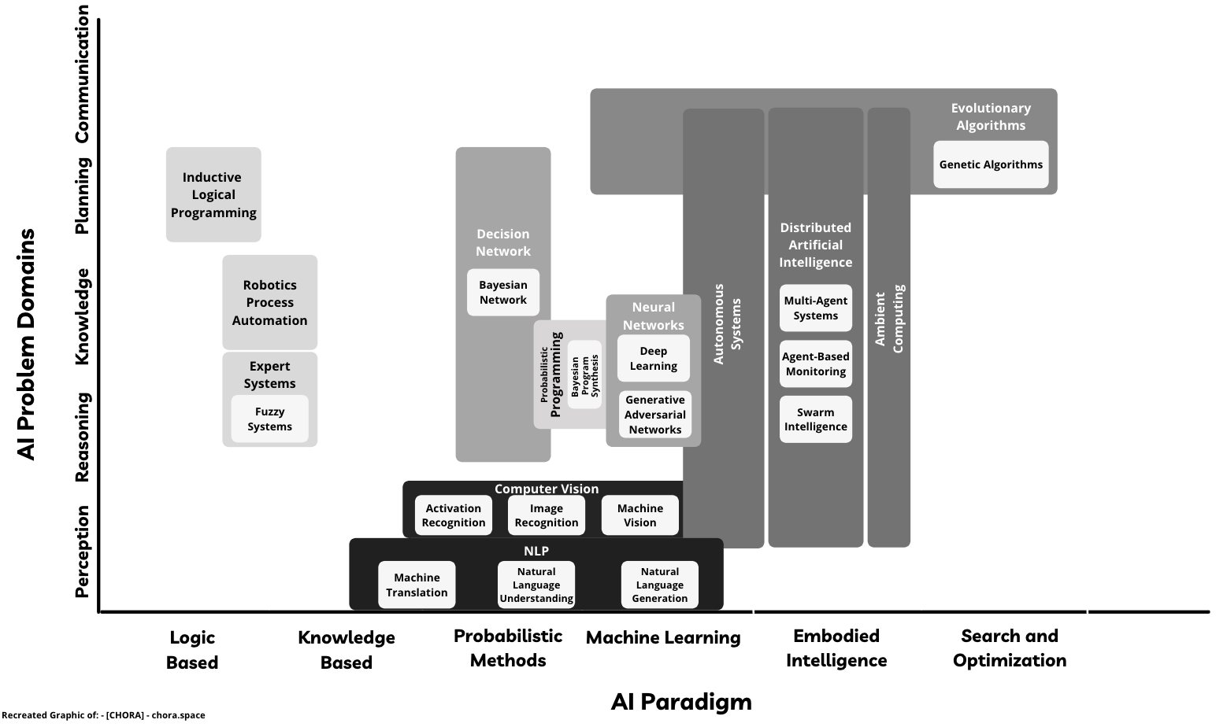
Taxonomy of AI/ML System
Notes:
Content:
Not every GenAI idea is worth pursuing immediately. Use a 3-factor model:
🔢 1. ROI (Return on Investment)
Time saved per sprint
Reduction in delivery delays or defects
Value of insight gained
🧩 2. Complexity
Data requirements and integration effort
Workflow disruption and training needs
Tool/vendor dependency
✅ 3. Feasibility
Team maturity and skills
Existing tool compatibility
Governance and AI policy readiness
Use This Matrix:
Quick Wins – High ROI, low complexity (start here)
Strategic Bets – High ROI, high complexity (plan for scale)
Deprioritized – Low ROI, high complexity (low leverage)
Example Exercise:
Score the "automated release note generator":
ROI = High
Complexity = Medium
Feasibility = High
→ Prioritize for pilot

Slide 11

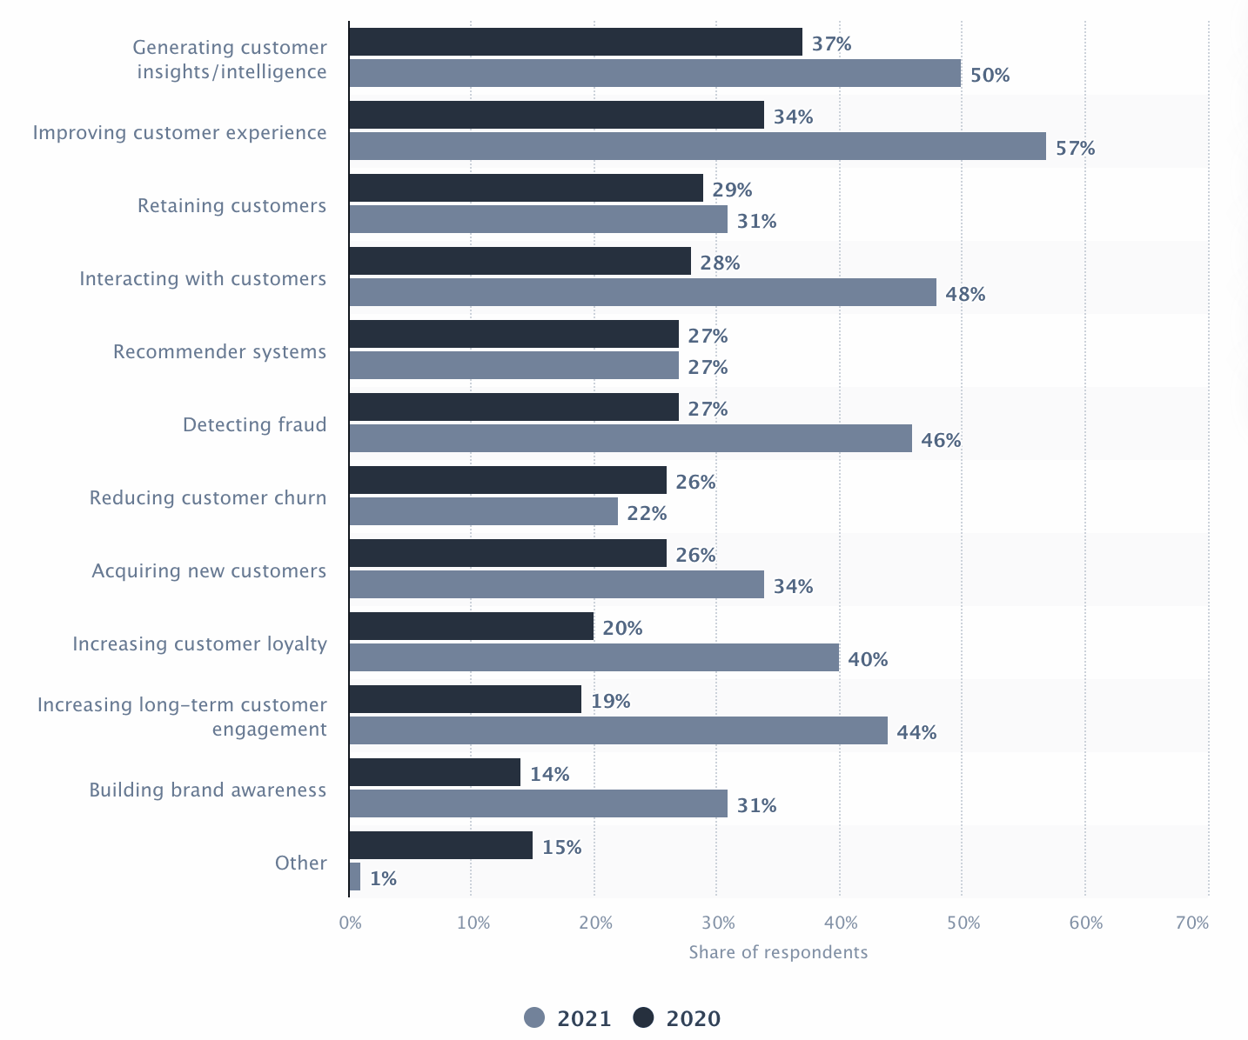






Capabilities and Use Cases
Object Detection
Speech Recognition / Sound Recognition
NLP / Sentiment Analysis
Predictions
Translation between Languages
Restoration & Transformation
Notes:
Content:
Not every GenAI idea is worth pursuing immediately. Use a 3-factor model:
🔢 1. ROI (Return on Investment)
Time saved per sprint
Reduction in delivery delays or defects
Value of insight gained
🧩 2. Complexity
Data requirements and integration effort
Workflow disruption and training needs
Tool/vendor dependency
✅ 3. Feasibility
Team maturity and skills
Existing tool compatibility
Governance and AI policy readiness
Use This Matrix:
Quick Wins – High ROI, low complexity (start here)
Strategic Bets – High ROI, high complexity (plan for scale)
Deprioritized – Low ROI, high complexity (low leverage)
Example Exercise:
Score the "automated release note generator":
ROI = High
Complexity = Medium
Feasibility = High
→ Prioritize for pilot

Slide 12




Capabilities and Use Cases
100,000+ customers have chosen AWS for AI to improve the quality of healthcare, and more.
AWS’ pre-trained AI Services offer ready-made intelligence for your applications and workflows. Get started by powering your applications in minutes: no machine learning knowledge required.
Increase in Team Productivity
Reduction in Processing Time
Deep Learning projects have better prediction rates
Amazon Transcribe
Amazon Polly
Amazon Comprehend
Amazon Rekognition
Amazon Translate
https://ai-service-demos.go-aws.com/
Notes:
Content:
Not every GenAI idea is worth pursuing immediately. Use a 3-factor model:
🔢 1. ROI (Return on Investment)
Time saved per sprint
Reduction in delivery delays or defects
Value of insight gained
🧩 2. Complexity
Data requirements and integration effort
Workflow disruption and training needs
Tool/vendor dependency
✅ 3. Feasibility
Team maturity and skills
Existing tool compatibility
Governance and AI policy readiness
Use This Matrix:
Quick Wins – High ROI, low complexity (start here)
Strategic Bets – High ROI, high complexity (plan for scale)
Deprioritized – Low ROI, high complexity (low leverage)
Example Exercise:
Score the "automated release note generator":
ROI = High
Complexity = Medium
Feasibility = High
→ Prioritize for pilot

Slide 13

Capabilities and Use Cases
Ham-or-Spam - An Intelligent spam filtering System
Ham-or-Spam is system which is used to classify the mails or messages or texts in two classes i.e. Ham or Spam.
According to Statista, globally 45.1% percentage of total email traffic were spam in 2021
https://ham-or-spam.herokuapp.com/
Notes:
Content:
Not every GenAI idea is worth pursuing immediately. Use a 3-factor model:
🔢 1. ROI (Return on Investment)
Time saved per sprint
Reduction in delivery delays or defects
Value of insight gained
🧩 2. Complexity
Data requirements and integration effort
Workflow disruption and training needs
Tool/vendor dependency
✅ 3. Feasibility
Team maturity and skills
Existing tool compatibility
Governance and AI policy readiness
Use This Matrix:
Quick Wins – High ROI, low complexity (start here)
Strategic Bets – High ROI, high complexity (plan for scale)
Deprioritized – Low ROI, high complexity (low leverage)
Example Exercise:
Score the "automated release note generator":
ROI = High
Complexity = Medium
Feasibility = High
→ Prioritize for pilot

Slide 14

Capabilities and Use Cases
Artificial Intelligence can improve the process of Hiring/Recruiting significantly
Establishing a fair recruitment process
Reducing errors in recruitment Process
Enabling better assessments
Increasing the use of analytics and metrics
Making the process faster and more efficient
Notes:
Content:
Not every GenAI idea is worth pursuing immediately. Use a 3-factor model:
🔢 1. ROI (Return on Investment)
Time saved per sprint
Reduction in delivery delays or defects
Value of insight gained
🧩 2. Complexity
Data requirements and integration effort
Workflow disruption and training needs
Tool/vendor dependency
✅ 3. Feasibility
Team maturity and skills
Existing tool compatibility
Governance and AI policy readiness
Use This Matrix:
Quick Wins – High ROI, low complexity (start here)
Strategic Bets – High ROI, high complexity (plan for scale)
Deprioritized – Low ROI, high complexity (low leverage)
Example Exercise:
Score the "automated release note generator":
ROI = High
Complexity = Medium
Feasibility = High
→ Prioritize for pilot

Slide 15
Types of Machine Learning
Machine Learning
Supervised
How it works?
Step 1. Label input data that defines output variables.
Step 2. Train the algorithm on the data to find the connection between input variables and output.
Step 3. Once training is complete, apply the algorithm to new data.
What is Supervised Learning?
An algorithm uses training data and feedback from human users to learn the relationship between given inputs and a given output
Notes:
Content:
Not every GenAI idea is worth pursuing immediately. Use a 3-factor model:
🔢 1. ROI (Return on Investment)
Time saved per sprint
Reduction in delivery delays or defects
Value of insight gained
🧩 2. Complexity
Data requirements and integration effort
Workflow disruption and training needs
Tool/vendor dependency
✅ 3. Feasibility
Team maturity and skills
Existing tool compatibility
Governance and AI policy readiness
Use This Matrix:
Quick Wins – High ROI, low complexity (start here)
Strategic Bets – High ROI, high complexity (plan for scale)
Deprioritized – Low ROI, high complexity (low leverage)
Example Exercise:
Score the "automated release note generator":
ROI = High
Complexity = Medium
Feasibility = High
→ Prioritize for pilot

Slide 16
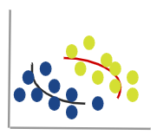
Types of Machine Learning
Machine Learning
Supervised
Unsupervised
What is Unsupervised Learning?
How it works?
It is more exploratory in nature. An algorithm explores relationships in input data without being provided an explicit output variable.
Step 1. Algorithm receives unlabeled data.
Step 2. It infers the schema from the data.
Step 3. The algorithm identifies groups of data that exhibit similar behavior.
Notes:
Content:
Not every GenAI idea is worth pursuing immediately. Use a 3-factor model:
🔢 1. ROI (Return on Investment)
Time saved per sprint
Reduction in delivery delays or defects
Value of insight gained
🧩 2. Complexity
Data requirements and integration effort
Workflow disruption and training needs
Tool/vendor dependency
✅ 3. Feasibility
Team maturity and skills
Existing tool compatibility
Governance and AI policy readiness
Use This Matrix:
Quick Wins – High ROI, low complexity (start here)
Strategic Bets – High ROI, high complexity (plan for scale)
Deprioritized – Low ROI, high complexity (low leverage)
Example Exercise:
Score the "automated release note generator":
ROI = High
Complexity = Medium
Feasibility = High
→ Prioritize for pilot

Slide 17
Types of Machine Learning
Machine Learning
Supervised
Unsupervised
Reinforcement
What is Reinforcement Learning?
How it Works?
An algorithm learns to perform a task simply by trying to maximize the rewards it would receive for its actions.
Step 1. Algorithm takes an action affecting the environment.
Step 2. It receives a reward if the action brings the machine a step closer to max. available reward.
Step 3. The algorithm optimizes for the best series of actions by correcting itself over time.
Algorithms
STATE
ACTION
REWARD
Environment
Notes:
Content:
Not every GenAI idea is worth pursuing immediately. Use a 3-factor model:
🔢 1. ROI (Return on Investment)
Time saved per sprint
Reduction in delivery delays or defects
Value of insight gained
🧩 2. Complexity
Data requirements and integration effort
Workflow disruption and training needs
Tool/vendor dependency
✅ 3. Feasibility
Team maturity and skills
Existing tool compatibility
Governance and AI policy readiness
Use This Matrix:
Quick Wins – High ROI, low complexity (start here)
Strategic Bets – High ROI, high complexity (plan for scale)
Deprioritized – Low ROI, high complexity (low leverage)
Example Exercise:
Score the "automated release note generator":
ROI = High
Complexity = Medium
Feasibility = High
→ Prioritize for pilot

Slide 18
Ways to perform Machine Learning
Requirements, Skillset, Compute, & Availability of Data influence the choice of approach
Less Flexible
More Flexible
Easiest Approach
Most complex Approach
Cognitive API
Auto ML
Transfer Learning
Build your own Model (BYOM)
Notes:
Content:
Not every GenAI idea is worth pursuing immediately. Use a 3-factor model:
🔢 1. ROI (Return on Investment)
Time saved per sprint
Reduction in delivery delays or defects
Value of insight gained
🧩 2. Complexity
Data requirements and integration effort
Workflow disruption and training needs
Tool/vendor dependency
✅ 3. Feasibility
Team maturity and skills
Existing tool compatibility
Governance and AI policy readiness
Use This Matrix:
Quick Wins – High ROI, low complexity (start here)
Strategic Bets – High ROI, high complexity (plan for scale)
Deprioritized – Low ROI, high complexity (low leverage)
Example Exercise:
Score the "automated release note generator":
ROI = High
Complexity = Medium
Feasibility = High
→ Prioritize for pilot

Slide 19




Ways to perform Machine Learning
Less Flexible / Easiest Approach
More Flexible / Most complex Approach
Cognitive API
Useful when you want to use pre-built models
Make a REST-based API call to invoke it
No Machine Learning skills required
Least flexible option
Amazon Polly
Text-to-Speech API
NLP
Amazon Rekognition
Vision API
Amazon Translate
Translation API
Amazon Transcribe
Speech-to-Text API
Amazon Comprehend
NLP API
Notes:
Content:
Not every GenAI idea is worth pursuing immediately. Use a 3-factor model:
🔢 1. ROI (Return on Investment)
Time saved per sprint
Reduction in delivery delays or defects
Value of insight gained
🧩 2. Complexity
Data requirements and integration effort
Workflow disruption and training needs
Tool/vendor dependency
✅ 3. Feasibility
Team maturity and skills
Existing tool compatibility
Governance and AI policy readiness
Use This Matrix:
Quick Wins – High ROI, low complexity (start here)
Strategic Bets – High ROI, high complexity (plan for scale)
Deprioritized – Low ROI, high complexity (low leverage)
Example Exercise:
Score the "automated release note generator":
ROI = High
Complexity = Medium
Feasibility = High
→ Prioritize for pilot

Slide 20


Ways to perform Machine Learning
Less Flexible / Easiest Approach
More Flexible / Most complex Approach
Cognitive API
Auto ML
An approach to automate Data Scientist’s work
Based on the concept “Using AI to Build AI”
No ML expertise required but correct data labeling necessary
Not much flexibility in terms of customization
Good for problems where you have an abundance of clean data and limited bandwidth of AI teams
10x
Increase in Data Science Team Productivity
54%
Less TCO compared to other clouds
Spend Time on What matters to you
AutoML for all
Full Transparency
End-to-End Solutions
Notes:
Content:
Not every GenAI idea is worth pursuing immediately. Use a 3-factor model:
🔢 1. ROI (Return on Investment)
Time saved per sprint
Reduction in delivery delays or defects
Value of insight gained
🧩 2. Complexity
Data requirements and integration effort
Workflow disruption and training needs
Tool/vendor dependency
✅ 3. Feasibility
Team maturity and skills
Existing tool compatibility
Governance and AI policy readiness
Use This Matrix:
Quick Wins – High ROI, low complexity (start here)
Strategic Bets – High ROI, high complexity (plan for scale)
Deprioritized – Low ROI, high complexity (low leverage)
Example Exercise:
Score the "automated release note generator":
ROI = High
Complexity = Medium
Feasibility = High
→ Prioritize for pilot

Slide 21
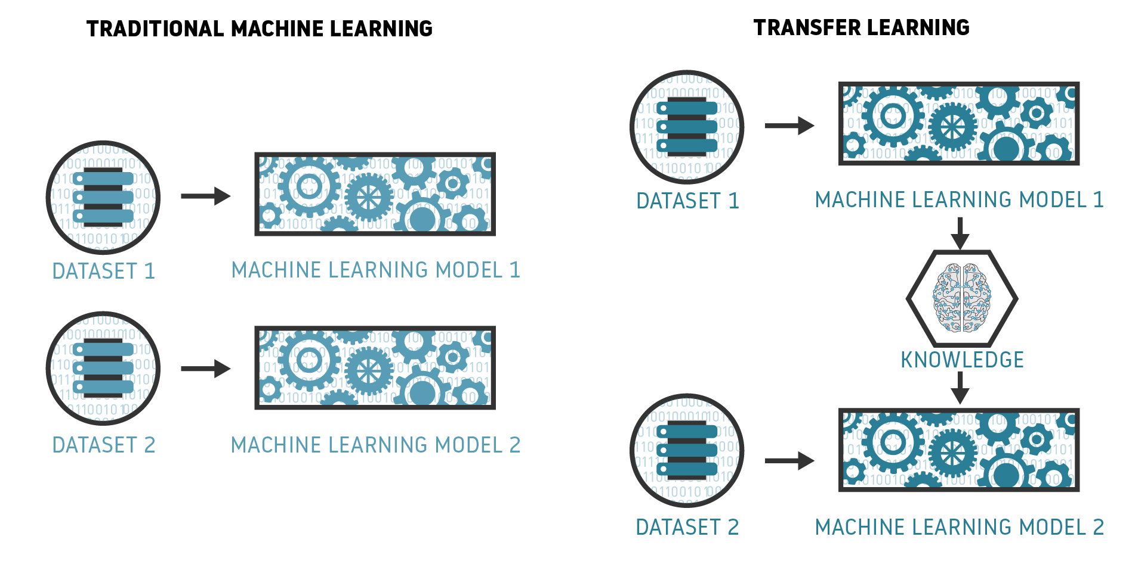
Ways to perform Machine Learning
Less Flexible / Easiest Approach
More Flexible / Most complex Approach
Cognitive API
Auto ML
Transfer Learning
Reuse experts’ knowledge
Requires Machine Learning expertise
Saves a lot of time and computational expense in model training
Provides some flexibility to fine-tune models
Requires relatively less data
TensorFlow Hub has many pre-built models
Notes:
Content:
Not every GenAI idea is worth pursuing immediately. Use a 3-factor model:
🔢 1. ROI (Return on Investment)
Time saved per sprint
Reduction in delivery delays or defects
Value of insight gained
🧩 2. Complexity
Data requirements and integration effort
Workflow disruption and training needs
Tool/vendor dependency
✅ 3. Feasibility
Team maturity and skills
Existing tool compatibility
Governance and AI policy readiness
Use This Matrix:
Quick Wins – High ROI, low complexity (start here)
Strategic Bets – High ROI, high complexity (plan for scale)
Deprioritized – Low ROI, high complexity (low leverage)
Example Exercise:
Score the "automated release note generator":
ROI = High
Complexity = Medium
Feasibility = High
→ Prioritize for pilot

Slide 22

Ways to perform Machine Learning
Less Flexible / Easiest Approach
More Flexible / Most complex Approach
Cognitive API
Auto ML
Transfer Learning
Bring your own Model
Most Flexible Approach
Requires Machine Learning Expertise
TensorFlow, Keras, PyTorch, etc., are the most commonly used libraries
Most used ML libraries and frameworks among developers
TensorFlow
16.53%
Keras
10.14%
PyTorch
9.89%
Apache
Spark
5.83%
Hadoop
4.43%
Notes:
Content:
Not every GenAI idea is worth pursuing immediately. Use a 3-factor model:
🔢 1. ROI (Return on Investment)
Time saved per sprint
Reduction in delivery delays or defects
Value of insight gained
🧩 2. Complexity
Data requirements and integration effort
Workflow disruption and training needs
Tool/vendor dependency
✅ 3. Feasibility
Team maturity and skills
Existing tool compatibility
Governance and AI policy readiness
Use This Matrix:
Quick Wins – High ROI, low complexity (start here)
Strategic Bets – High ROI, high complexity (plan for scale)
Deprioritized – Low ROI, high complexity (low leverage)
Example Exercise:
Score the "automated release note generator":
ROI = High
Complexity = Medium
Feasibility = High
→ Prioritize for pilot

Slide 23
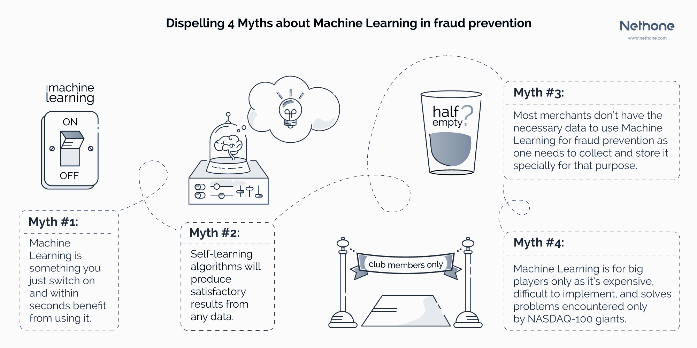
Myths around Machine Learning
Notes:
Content:
Not every GenAI idea is worth pursuing immediately. Use a 3-factor model:
🔢 1. ROI (Return on Investment)
Time saved per sprint
Reduction in delivery delays or defects
Value of insight gained
🧩 2. Complexity
Data requirements and integration effort
Workflow disruption and training needs
Tool/vendor dependency
✅ 3. Feasibility
Team maturity and skills
Existing tool compatibility
Governance and AI policy readiness
Use This Matrix:
Quick Wins – High ROI, low complexity (start here)
Strategic Bets – High ROI, high complexity (plan for scale)
Deprioritized – Low ROI, high complexity (low leverage)
Example Exercise:
Score the "automated release note generator":
ROI = High
Complexity = Medium
Feasibility = High
→ Prioritize for pilot

Slide 24
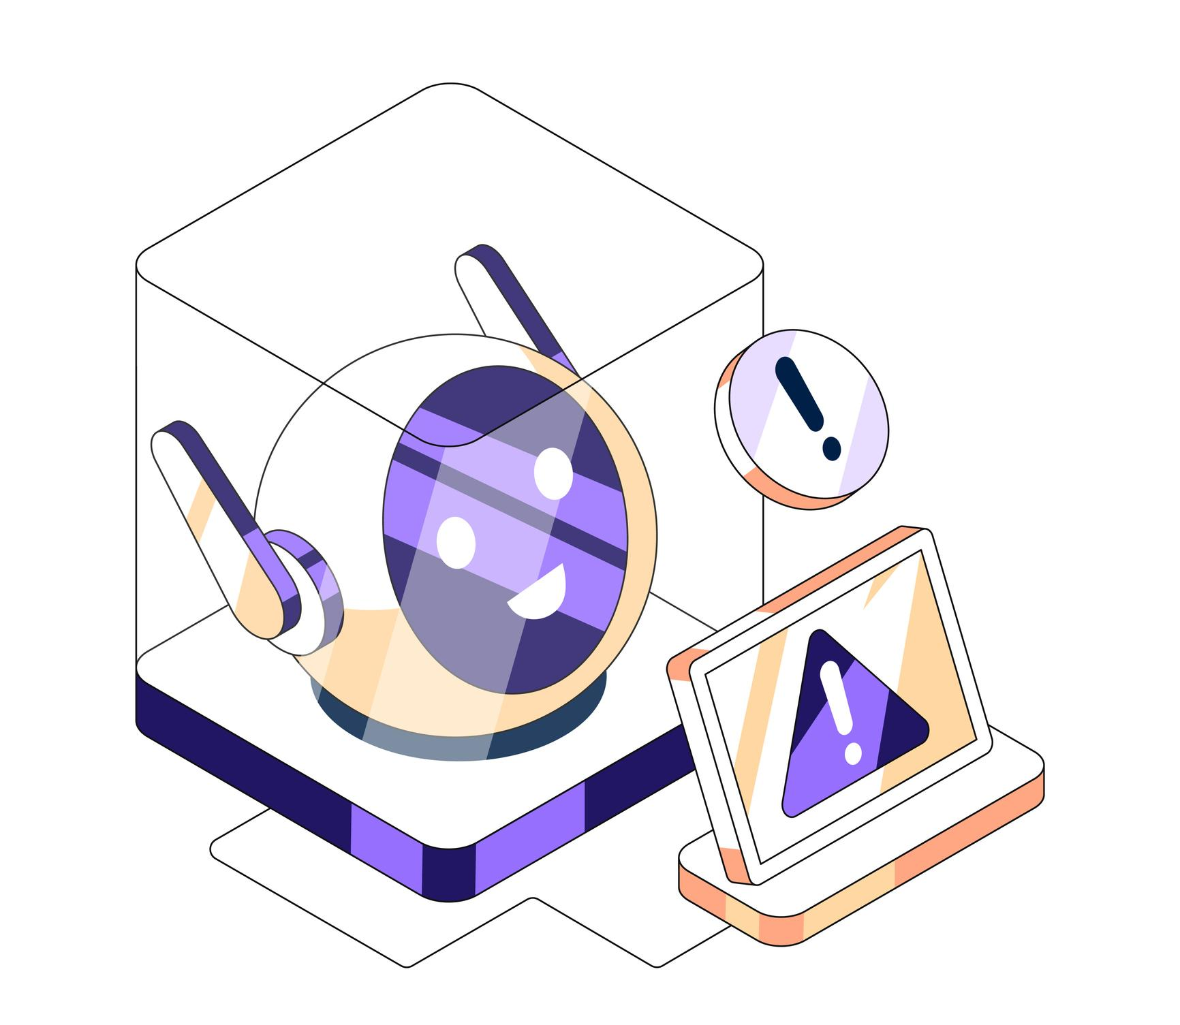
Common limitations
Limitation | Why It Happens | Impact
Data Quality | Poor or incomplete data | Wrong predictions
Bias | Biased historical data | Unfair outcomes
Expectations | Overhype of AI | Disappointment & misuse
Notes:
Content:
Not every GenAI idea is worth pursuing immediately. Use a 3-factor model:
🔢 1. ROI (Return on Investment)
Time saved per sprint
Reduction in delivery delays or defects
Value of insight gained
🧩 2. Complexity
Data requirements and integration effort
Workflow disruption and training needs
Tool/vendor dependency
✅ 3. Feasibility
Team maturity and skills
Existing tool compatibility
Governance and AI policy readiness
Use This Matrix:
Quick Wins – High ROI, low complexity (start here)
Strategic Bets – High ROI, high complexity (plan for scale)
Deprioritized – Low ROI, high complexity (low leverage)
Example Exercise:
Score the "automated release note generator":
ROI = High
Complexity = Medium
Feasibility = High
→ Prioritize for pilot

Slide 25
Introduction to AI & Machine Learning Fundamentals
Data, Preprocessing, and Exploratory Data Analysis (EDA)
Python for Machine Learning
Regression – Simple Linear Regression
AGENDA

Slide 26



Data Types: Numeric vs Categorical
Numeric
Continuous / discrete — e.g., height, price, counts
Categorical
Nominal or ordinal — e.g., country, customer segment, rating tier
Implication
Choose encoders, scalers and tests appropriate to type
Notes:
Content:
Not every GenAI idea is worth pursuing immediately. Use a 3-factor model:
🔢 1. ROI (Return on Investment)
Time saved per sprint
Reduction in delivery delays or defects
Value of insight gained
🧩 2. Complexity
Data requirements and integration effort
Workflow disruption and training needs
Tool/vendor dependency
✅ 3. Feasibility
Team maturity and skills
Existing tool compatibility
Governance and AI policy readiness
Use This Matrix:
Quick Wins – High ROI, low complexity (start here)
Strategic Bets – High ROI, high complexity (plan for scale)
Deprioritized – Low ROI, high complexity (low leverage)
Example Exercise:
Score the "automated release note generator":
ROI = High
Complexity = Medium
Feasibility = High
→ Prioritize for pilot

Slide 27
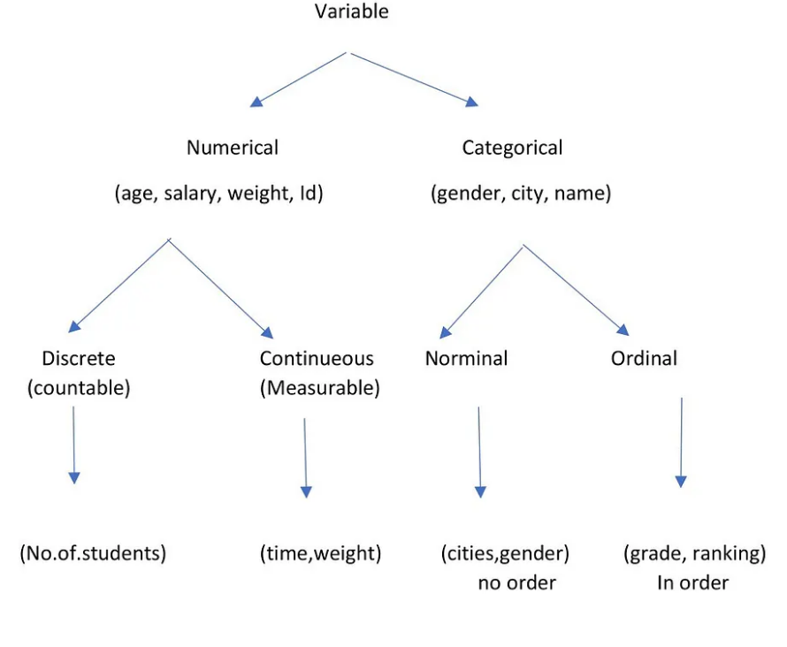
Variables
Categorical variable: The variables containing details like name, gender, address, company, job role, etc are called categorical variables.
Data type: categorical, object
Numerical variable: The variable that contains details like id, salary, class is called a numerical variable.
Data type: integer, float
Notes:
Content:
Not every GenAI idea is worth pursuing immediately. Use a 3-factor model:
🔢 1. ROI (Return on Investment)
Time saved per sprint
Reduction in delivery delays or defects
Value of insight gained
🧩 2. Complexity
Data requirements and integration effort
Workflow disruption and training needs
Tool/vendor dependency
✅ 3. Feasibility
Team maturity and skills
Existing tool compatibility
Governance and AI policy readiness
Use This Matrix:
Quick Wins – High ROI, low complexity (start here)
Strategic Bets – High ROI, high complexity (plan for scale)
Deprioritized – Low ROI, high complexity (low leverage)
Example Exercise:
Score the "automated release note generator":
ROI = High
Complexity = Medium
Feasibility = High
→ Prioritize for pilot

Slide 28
Data Preprocessing Pipeline (Iterative in nature)
Data Gathering
Data Encoding
Class Imbalance
Data Exploration
Outlier Detection
Data Skew
Dimensionality Reduction
Handling Missing Data
Feature Engineering
Data Normalization
Data Filtering
Data Sorting
Notes:
Content:
Not every GenAI idea is worth pursuing immediately. Use a 3-factor model:
🔢 1. ROI (Return on Investment)
Time saved per sprint
Reduction in delivery delays or defects
Value of insight gained
🧩 2. Complexity
Data requirements and integration effort
Workflow disruption and training needs
Tool/vendor dependency
✅ 3. Feasibility
Team maturity and skills
Existing tool compatibility
Governance and AI policy readiness
Use This Matrix:
Quick Wins – High ROI, low complexity (start here)
Strategic Bets – High ROI, high complexity (plan for scale)
Deprioritized – Low ROI, high complexity (low leverage)
Example Exercise:
Score the "automated release note generator":
ROI = High
Complexity = Medium
Feasibility = High
→ Prioritize for pilot

Slide 29
Data Preprocessing
Data preprocessing is the first step in any data analysis or machine learning pipeline.
It involves cleaning, transforming and organizing raw data to ensure it is accurate, consistent and ready for modeling. It has a big impact on model building such as:
Clean and well-structured data allows models to learn meaningful patterns rather than noise.
Organized data supports better Exploratory Data Analysis (EDA), making patterns and trends more interpretable.
Notes:
Content:
Not every GenAI idea is worth pursuing immediately. Use a 3-factor model:
🔢 1. ROI (Return on Investment)
Time saved per sprint
Reduction in delivery delays or defects
Value of insight gained
🧩 2. Complexity
Data requirements and integration effort
Workflow disruption and training needs
Tool/vendor dependency
✅ 3. Feasibility
Team maturity and skills
Existing tool compatibility
Governance and AI policy readiness
Use This Matrix:
Quick Wins – High ROI, low complexity (start here)
Strategic Bets – High ROI, high complexity (plan for scale)
Deprioritized – Low ROI, high complexity (low leverage)
Example Exercise:
Score the "automated release note generator":
ROI = High
Complexity = Medium
Feasibility = High
→ Prioritize for pilot

Slide 30
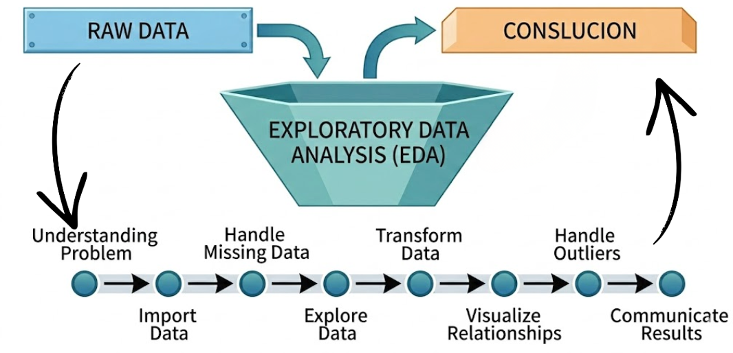
What’s Exploratory data analysis?
Exploratory data analysis (EDA) is a term for certain kinds of initial analysis and findings done with data sets, usually early on in an analytical process. Some experts describe it as “taking a peek” at the data to understand more about what it represents and how to apply it.
Notes:
Content:
Not every GenAI idea is worth pursuing immediately. Use a 3-factor model:
🔢 1. ROI (Return on Investment)
Time saved per sprint
Reduction in delivery delays or defects
Value of insight gained
🧩 2. Complexity
Data requirements and integration effort
Workflow disruption and training needs
Tool/vendor dependency
✅ 3. Feasibility
Team maturity and skills
Existing tool compatibility
Governance and AI policy readiness
Use This Matrix:
Quick Wins – High ROI, low complexity (start here)
Strategic Bets – High ROI, high complexity (plan for scale)
Deprioritized – Low ROI, high complexity (low leverage)
Example Exercise:
Score the "automated release note generator":
ROI = High
Complexity = Medium
Feasibility = High
→ Prioritize for pilot

Slide 31
EDA Techniques
Python offers various libraries like pandas, numPy, matplotlib, seaborn and plotly which enables effective exploration and insights generation to help in further modeling and analysis.
Some common EDA techniques are:
Data Inspection: Check the size of the dataset, how it is organized, the types of data it contains and basic summary values.
Handling Missing and Duplicate Data: Find and fix empty values or repeated rows to keep the data clean.
Univariate Analysis: Study one variable at a time to understand its distribution, trend and outliers.
Bivariate Analysis: Compare two variables to see how they are related.
Multivariate Analysis: Analyze three or more variables together to understand deeper relationships.
Notes:
Content:
Not every GenAI idea is worth pursuing immediately. Use a 3-factor model:
🔢 1. ROI (Return on Investment)
Time saved per sprint
Reduction in delivery delays or defects
Value of insight gained
🧩 2. Complexity
Data requirements and integration effort
Workflow disruption and training needs
Tool/vendor dependency
✅ 3. Feasibility
Team maturity and skills
Existing tool compatibility
Governance and AI policy readiness
Use This Matrix:
Quick Wins – High ROI, low complexity (start here)
Strategic Bets – High ROI, high complexity (plan for scale)
Deprioritized – Low ROI, high complexity (low leverage)
Example Exercise:
Score the "automated release note generator":
ROI = High
Complexity = Medium
Feasibility = High
→ Prioritize for pilot

Slide 32
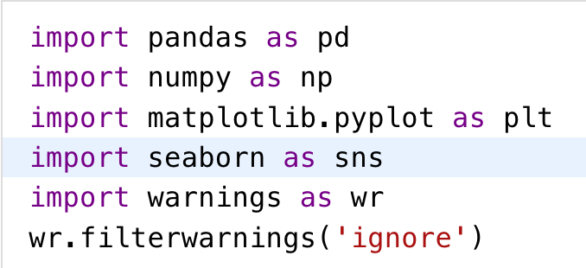
Key Steps for Exploratory Data Analysis
Step 1: Importing Required Libraries
Notes:
Content:
Not every GenAI idea is worth pursuing immediately. Use a 3-factor model:
🔢 1. ROI (Return on Investment)
Time saved per sprint
Reduction in delivery delays or defects
Value of insight gained
🧩 2. Complexity
Data requirements and integration effort
Workflow disruption and training needs
Tool/vendor dependency
✅ 3. Feasibility
Team maturity and skills
Existing tool compatibility
Governance and AI policy readiness
Use This Matrix:
Quick Wins – High ROI, low complexity (start here)
Strategic Bets – High ROI, high complexity (plan for scale)
Deprioritized – Low ROI, high complexity (low leverage)
Example Exercise:
Score the "automated release note generator":
ROI = High
Complexity = Medium
Feasibility = High
→ Prioritize for pilot

Slide 33
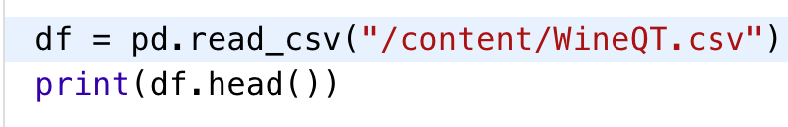
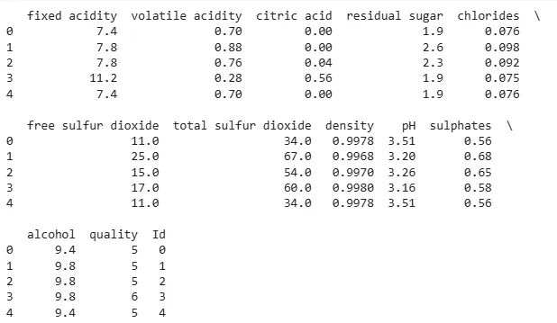
Key Steps for Exploratory Data Analysis (continued)
Step 2: Reading Dataset
Notes:
Content:
Not every GenAI idea is worth pursuing immediately. Use a 3-factor model:
🔢 1. ROI (Return on Investment)
Time saved per sprint
Reduction in delivery delays or defects
Value of insight gained
🧩 2. Complexity
Data requirements and integration effort
Workflow disruption and training needs
Tool/vendor dependency
✅ 3. Feasibility
Team maturity and skills
Existing tool compatibility
Governance and AI policy readiness
Use This Matrix:
Quick Wins – High ROI, low complexity (start here)
Strategic Bets – High ROI, high complexity (plan for scale)
Deprioritized – Low ROI, high complexity (low leverage)
Example Exercise:
Score the "automated release note generator":
ROI = High
Complexity = Medium
Feasibility = High
→ Prioritize for pilot

Slide 34
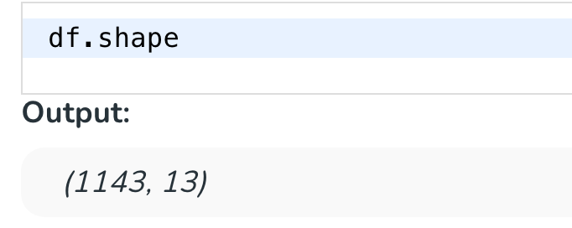
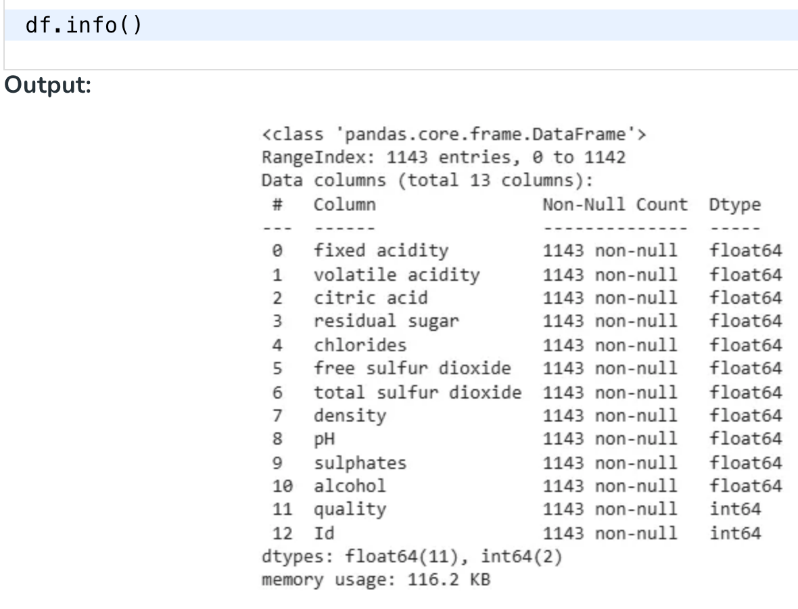
Key Steps for Exploratory Data Analysis (continued)
Step 3: Analyzing the Data
1. df.shape(): This function is used to understand the number of rows (observations) and columns (features) in the dataset. This gives an overview of the dataset's size and structure.
2. df.info(): This function helps us to understand the dataset by showing the number of records in each column, type of data, whether any values are missing and how much memory the dataset uses.
Notes:
Content:
Not every GenAI idea is worth pursuing immediately. Use a 3-factor model:
🔢 1. ROI (Return on Investment)
Time saved per sprint
Reduction in delivery delays or defects
Value of insight gained
🧩 2. Complexity
Data requirements and integration effort
Workflow disruption and training needs
Tool/vendor dependency
✅ 3. Feasibility
Team maturity and skills
Existing tool compatibility
Governance and AI policy readiness
Use This Matrix:
Quick Wins – High ROI, low complexity (start here)
Strategic Bets – High ROI, high complexity (plan for scale)
Deprioritized – Low ROI, high complexity (low leverage)
Example Exercise:
Score the "automated release note generator":
ROI = High
Complexity = Medium
Feasibility = High
→ Prioritize for pilot

Slide 35
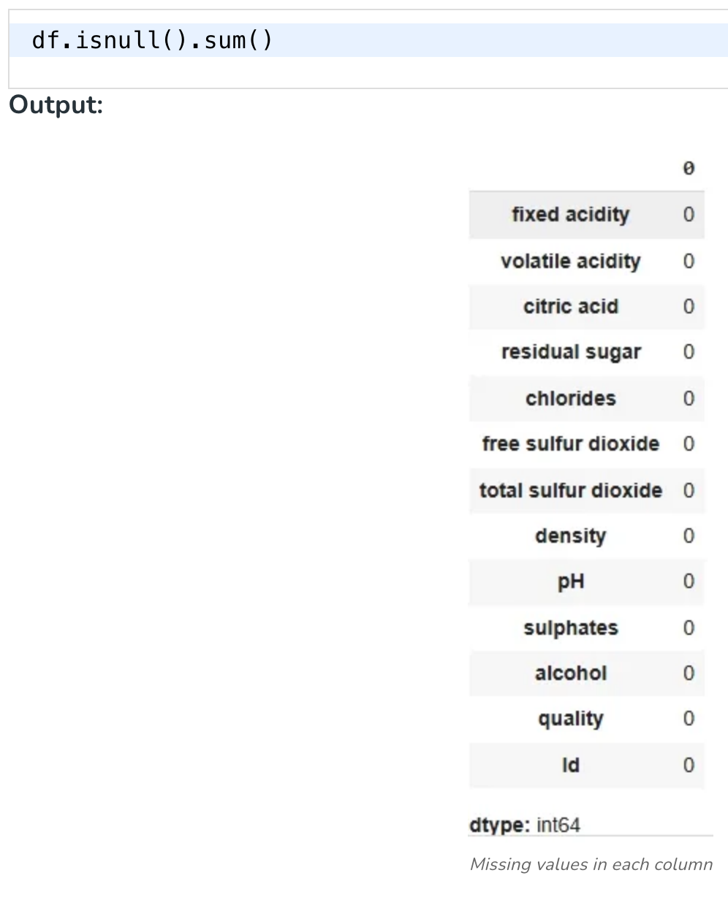
Key Steps for Exploratory Data Analysis (continued)
Step 4: Checking Missing Values
df.isnull().sum(): This checks for missing values in each column and returns the total number of null values per column helping us to identify any gaps in our data.
Notes:
Content:
Not every GenAI idea is worth pursuing immediately. Use a 3-factor model:
🔢 1. ROI (Return on Investment)
Time saved per sprint
Reduction in delivery delays or defects
Value of insight gained
🧩 2. Complexity
Data requirements and integration effort
Workflow disruption and training needs
Tool/vendor dependency
✅ 3. Feasibility
Team maturity and skills
Existing tool compatibility
Governance and AI policy readiness
Use This Matrix:
Quick Wins – High ROI, low complexity (start here)
Strategic Bets – High ROI, high complexity (plan for scale)
Deprioritized – Low ROI, high complexity (low leverage)
Example Exercise:
Score the "automated release note generator":
ROI = High
Complexity = Medium
Feasibility = High
→ Prioritize for pilot

Slide 36
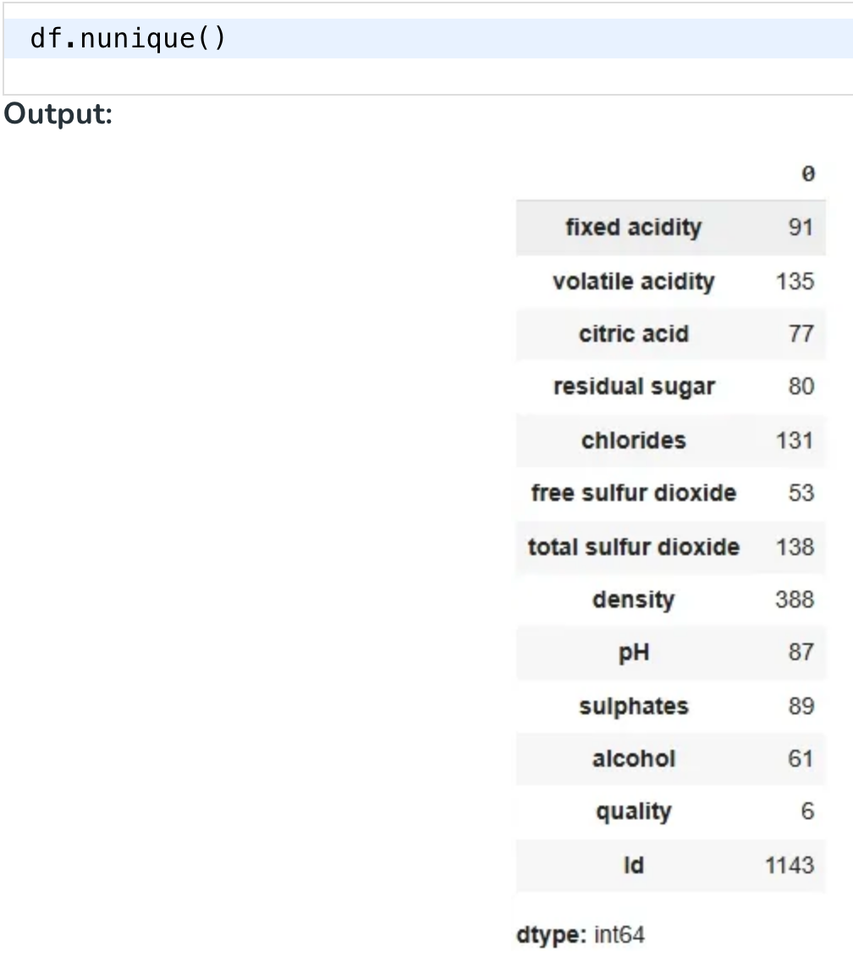
Key Steps for Exploratory Data Analysis (continued)
Step 5: Checking for the duplicate values
df.nunique(): This function tells us how many unique values exist in each column which provides insight into the variety of data in each feature.
Notes:
Content:
Not every GenAI idea is worth pursuing immediately. Use a 3-factor model:
🔢 1. ROI (Return on Investment)
Time saved per sprint
Reduction in delivery delays or defects
Value of insight gained
🧩 2. Complexity
Data requirements and integration effort
Workflow disruption and training needs
Tool/vendor dependency
✅ 3. Feasibility
Team maturity and skills
Existing tool compatibility
Governance and AI policy readiness
Use This Matrix:
Quick Wins – High ROI, low complexity (start here)
Strategic Bets – High ROI, high complexity (plan for scale)
Deprioritized – Low ROI, high complexity (low leverage)
Example Exercise:
Score the "automated release note generator":
ROI = High
Complexity = Medium
Feasibility = High
→ Prioritize for pilot

Slide 37
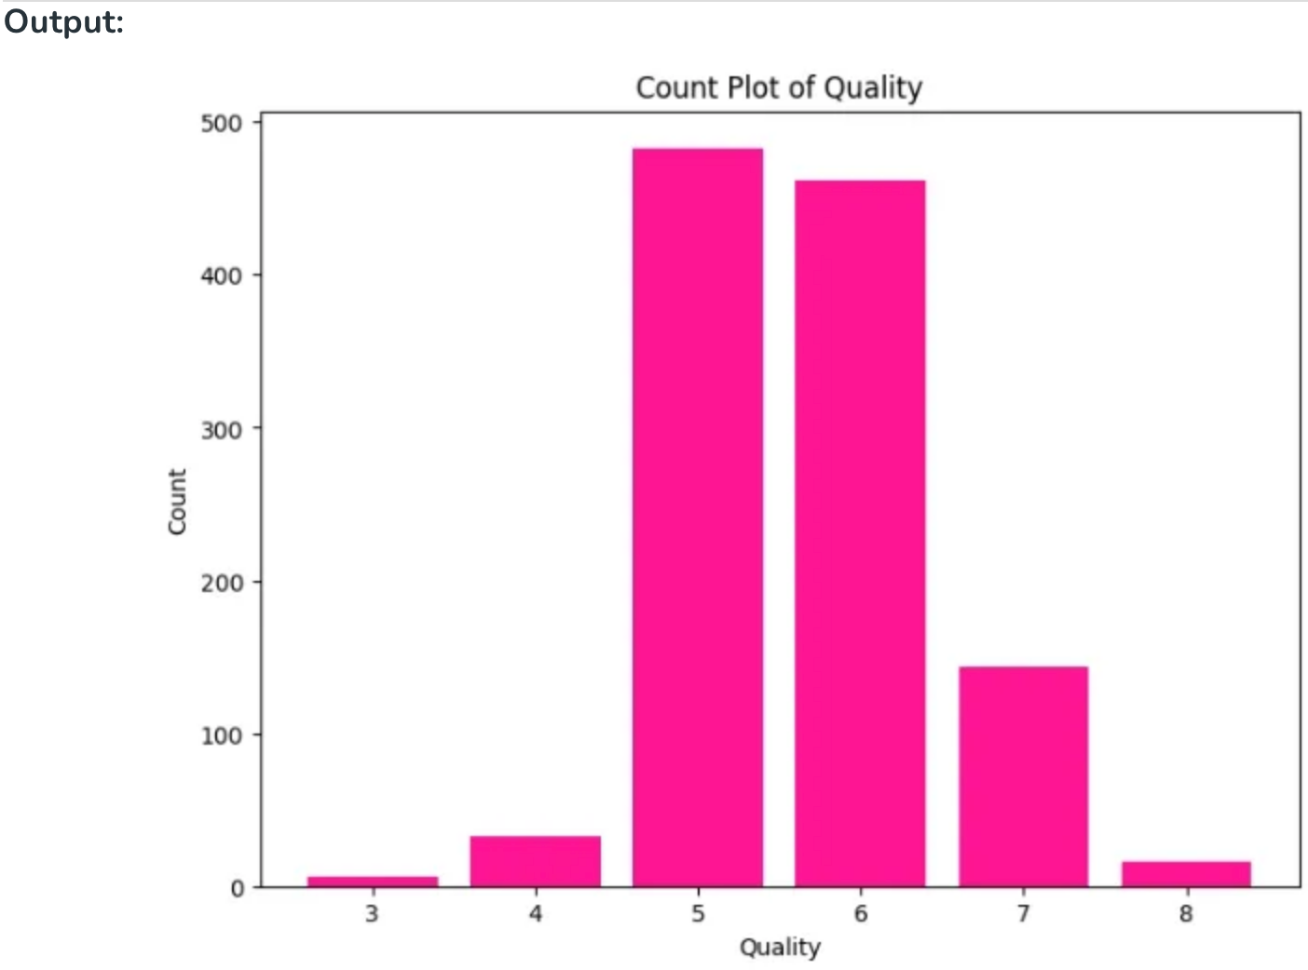
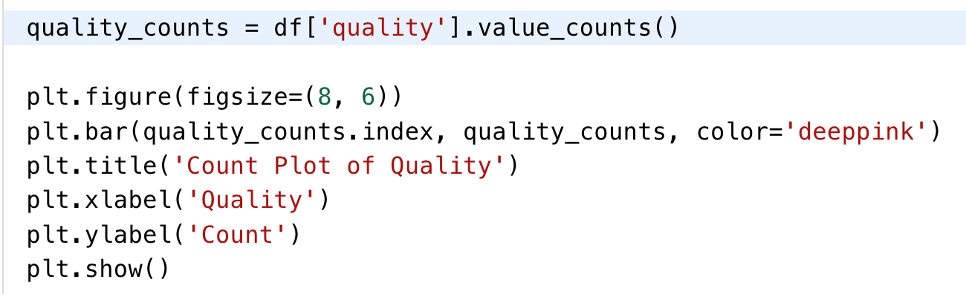
Key Steps for Exploratory Data Analysis (continued)
Step 6: Univariate Analysis
In Univariate analysis plotting the right charts can help us to better understand the data making the data visualization so important.
1. Bar Plot for evaluating the count of the wine with its quality rate
Notes:
Content:
Not every GenAI idea is worth pursuing immediately. Use a 3-factor model:
🔢 1. ROI (Return on Investment)
Time saved per sprint
Reduction in delivery delays or defects
Value of insight gained
🧩 2. Complexity
Data requirements and integration effort
Workflow disruption and training needs
Tool/vendor dependency
✅ 3. Feasibility
Team maturity and skills
Existing tool compatibility
Governance and AI policy readiness
Use This Matrix:
Quick Wins – High ROI, low complexity (start here)
Strategic Bets – High ROI, high complexity (plan for scale)
Deprioritized – Low ROI, high complexity (low leverage)
Example Exercise:
Score the "automated release note generator":
ROI = High
Complexity = Medium
Feasibility = High
→ Prioritize for pilot

Slide 38
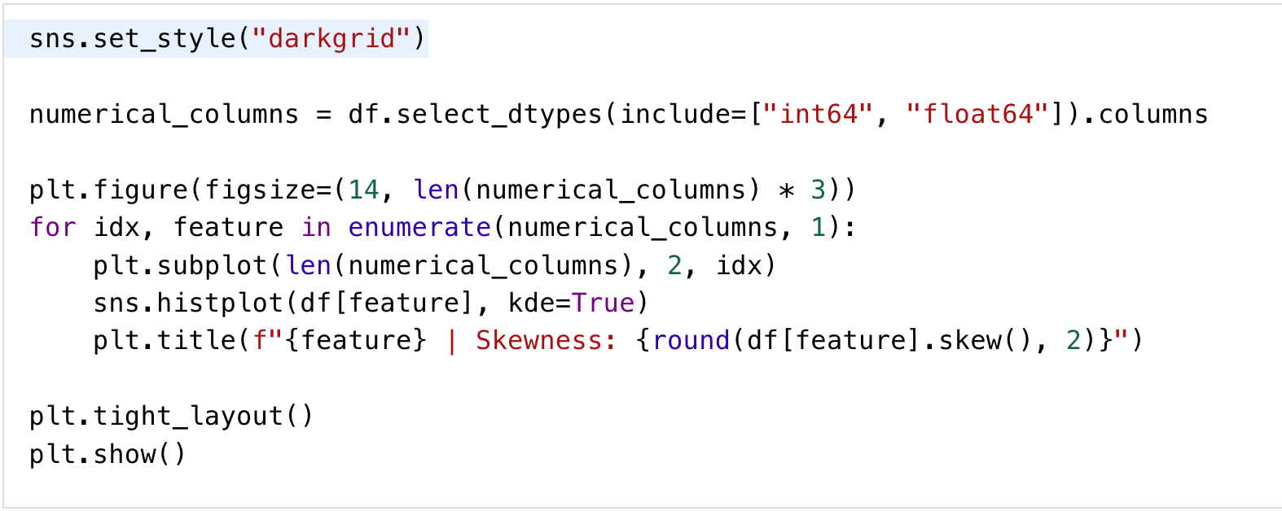
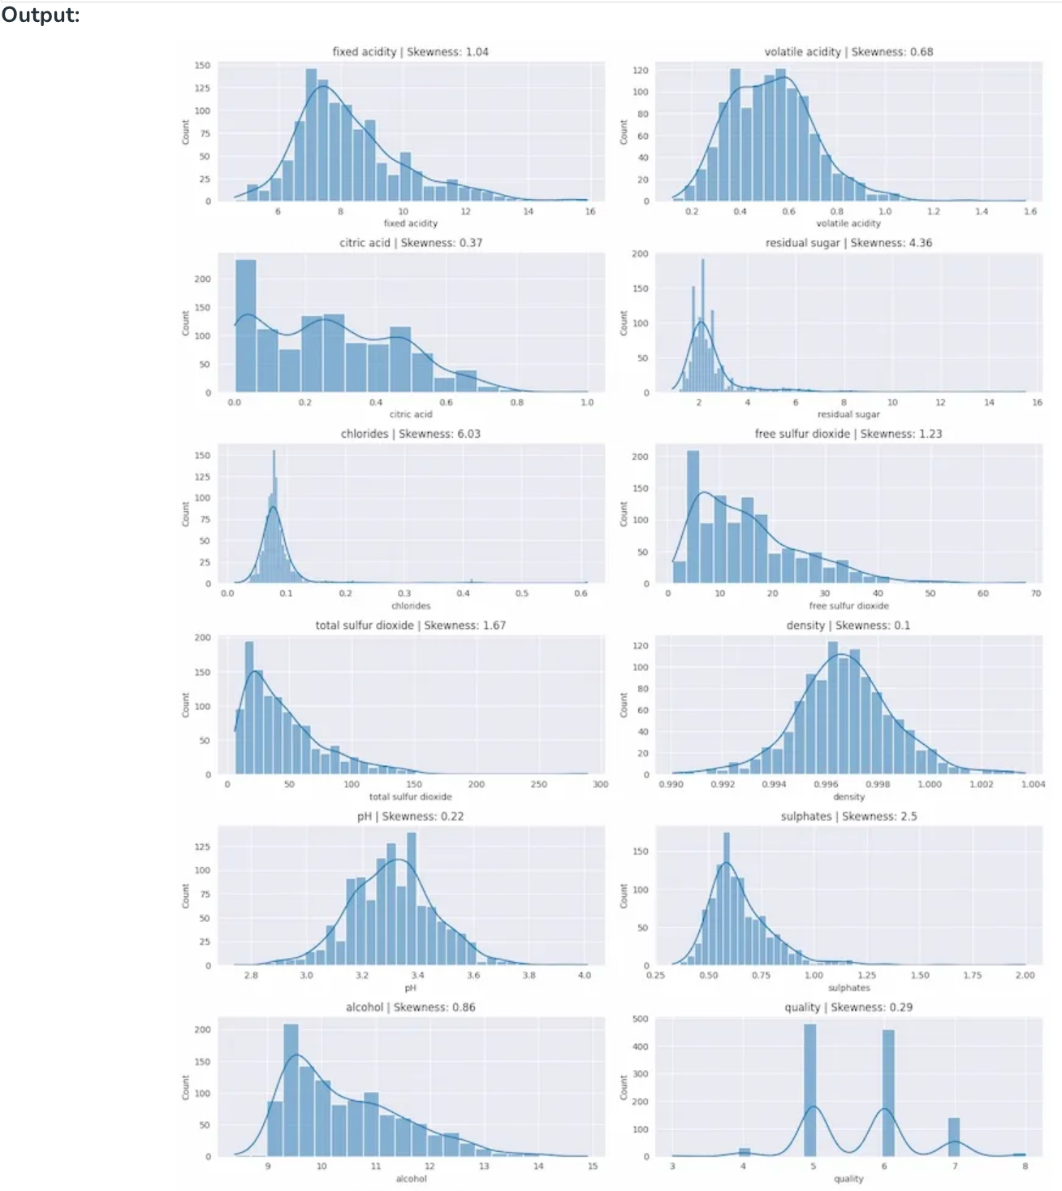
Key Steps for Exploratory Data Analysis (continued)
Step 6: Univariate Analysis
2. Kernel density plot for understanding variance in the dataset
Notes:
Content:
Not every GenAI idea is worth pursuing immediately. Use a 3-factor model:
🔢 1. ROI (Return on Investment)
Time saved per sprint
Reduction in delivery delays or defects
Value of insight gained
🧩 2. Complexity
Data requirements and integration effort
Workflow disruption and training needs
Tool/vendor dependency
✅ 3. Feasibility
Team maturity and skills
Existing tool compatibility
Governance and AI policy readiness
Use This Matrix:
Quick Wins – High ROI, low complexity (start here)
Strategic Bets – High ROI, high complexity (plan for scale)
Deprioritized – Low ROI, high complexity (low leverage)
Example Exercise:
Score the "automated release note generator":
ROI = High
Complexity = Medium
Feasibility = High
→ Prioritize for pilot

Slide 39
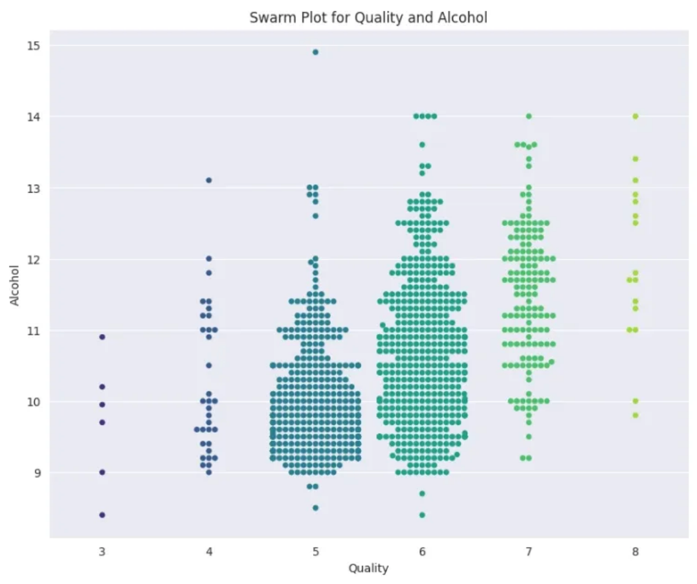
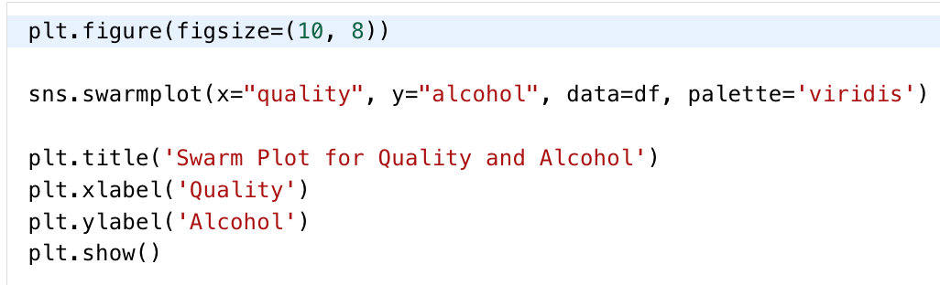
Key Steps for Exploratory Data Analysis (continued)
Step 6: Univariate Analysis
3. Swarm Plot for showing the outlier in the data
Notes:
Content:
Not every GenAI idea is worth pursuing immediately. Use a 3-factor model:
🔢 1. ROI (Return on Investment)
Time saved per sprint
Reduction in delivery delays or defects
Value of insight gained
🧩 2. Complexity
Data requirements and integration effort
Workflow disruption and training needs
Tool/vendor dependency
✅ 3. Feasibility
Team maturity and skills
Existing tool compatibility
Governance and AI policy readiness
Use This Matrix:
Quick Wins – High ROI, low complexity (start here)
Strategic Bets – High ROI, high complexity (plan for scale)
Deprioritized – Low ROI, high complexity (low leverage)
Example Exercise:
Score the "automated release note generator":
ROI = High
Complexity = Medium
Feasibility = High
→ Prioritize for pilot

Slide 40
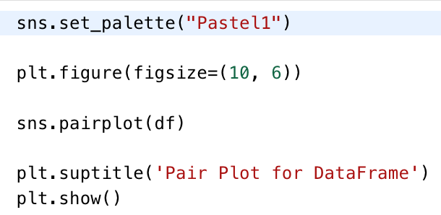

Key Steps for Exploratory Data Analysis (continued)
Step 7: Bivariate Analysis
In bivariate analysis two variables are analyzed together to identify patterns, dependencies or interactions between them. This method helps in understanding how changes in one variable might affect another.
1. Pair Plot for showing the distribution of the individual variables
Notes:
Content:
Not every GenAI idea is worth pursuing immediately. Use a 3-factor model:
🔢 1. ROI (Return on Investment)
Time saved per sprint
Reduction in delivery delays or defects
Value of insight gained
🧩 2. Complexity
Data requirements and integration effort
Workflow disruption and training needs
Tool/vendor dependency
✅ 3. Feasibility
Team maturity and skills
Existing tool compatibility
Governance and AI policy readiness
Use This Matrix:
Quick Wins – High ROI, low complexity (start here)
Strategic Bets – High ROI, high complexity (plan for scale)
Deprioritized – Low ROI, high complexity (low leverage)
Example Exercise:
Score the "automated release note generator":
ROI = High
Complexity = Medium
Feasibility = High
→ Prioritize for pilot

Slide 41
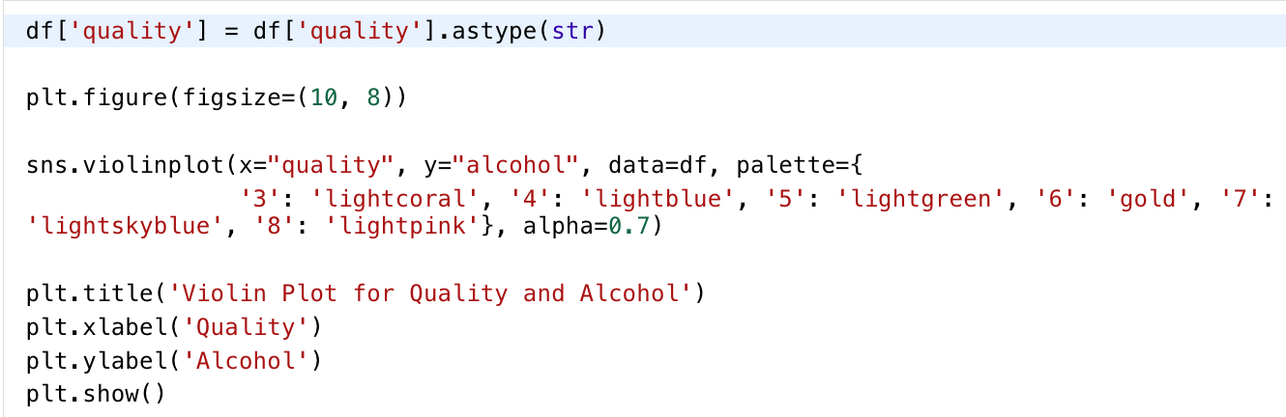
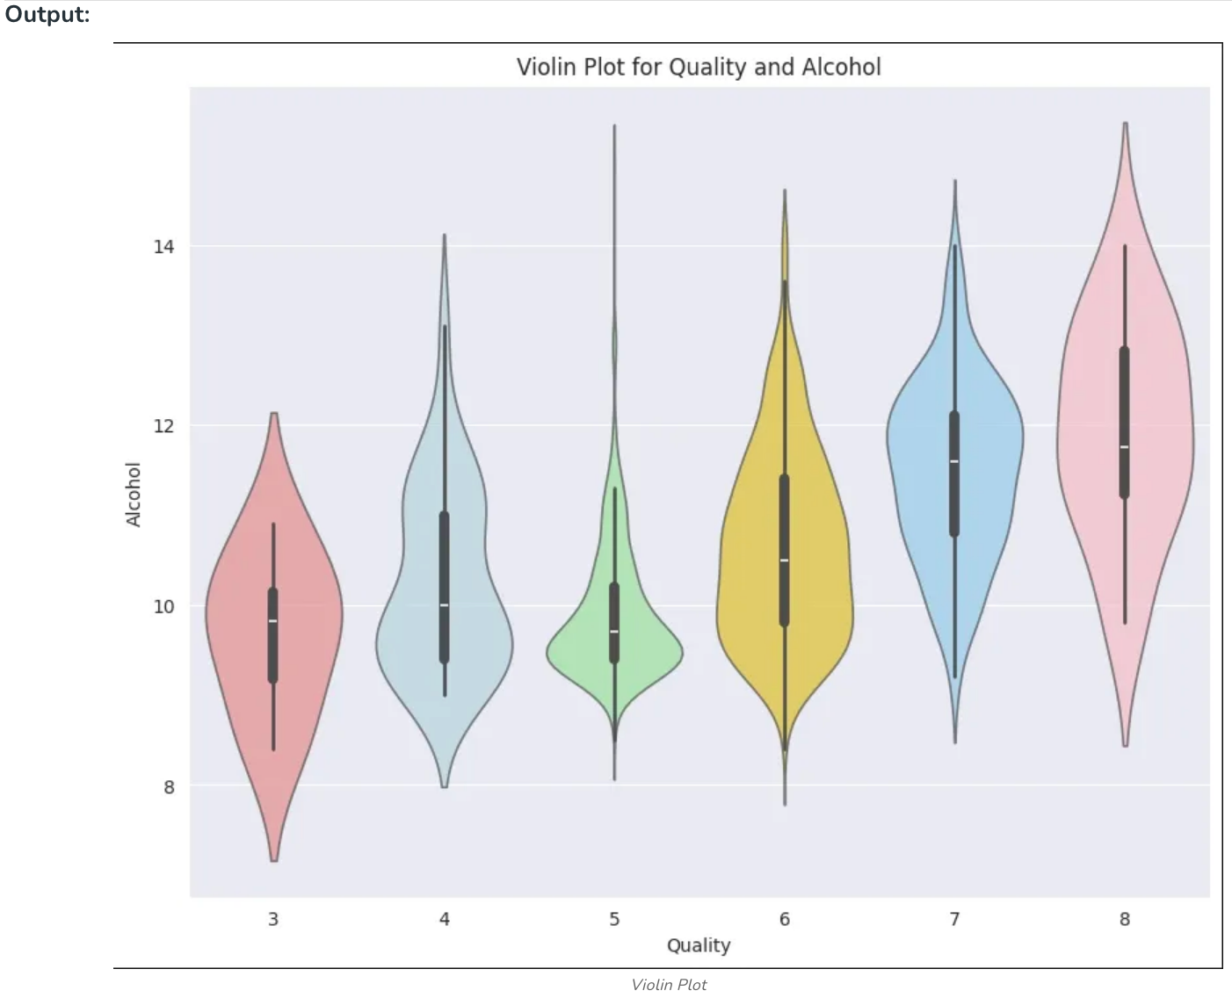
Key Steps for Exploratory Data Analysis (continued)
Step 7: Bivariate Analysis
2. Violin Plot for examining the relationship between alcohol and Quality.
Notes:
Content:
Not every GenAI idea is worth pursuing immediately. Use a 3-factor model:
🔢 1. ROI (Return on Investment)
Time saved per sprint
Reduction in delivery delays or defects
Value of insight gained
🧩 2. Complexity
Data requirements and integration effort
Workflow disruption and training needs
Tool/vendor dependency
✅ 3. Feasibility
Team maturity and skills
Existing tool compatibility
Governance and AI policy readiness
Use This Matrix:
Quick Wins – High ROI, low complexity (start here)
Strategic Bets – High ROI, high complexity (plan for scale)
Deprioritized – Low ROI, high complexity (low leverage)
Example Exercise:
Score the "automated release note generator":
ROI = High
Complexity = Medium
Feasibility = High
→ Prioritize for pilot

Slide 42

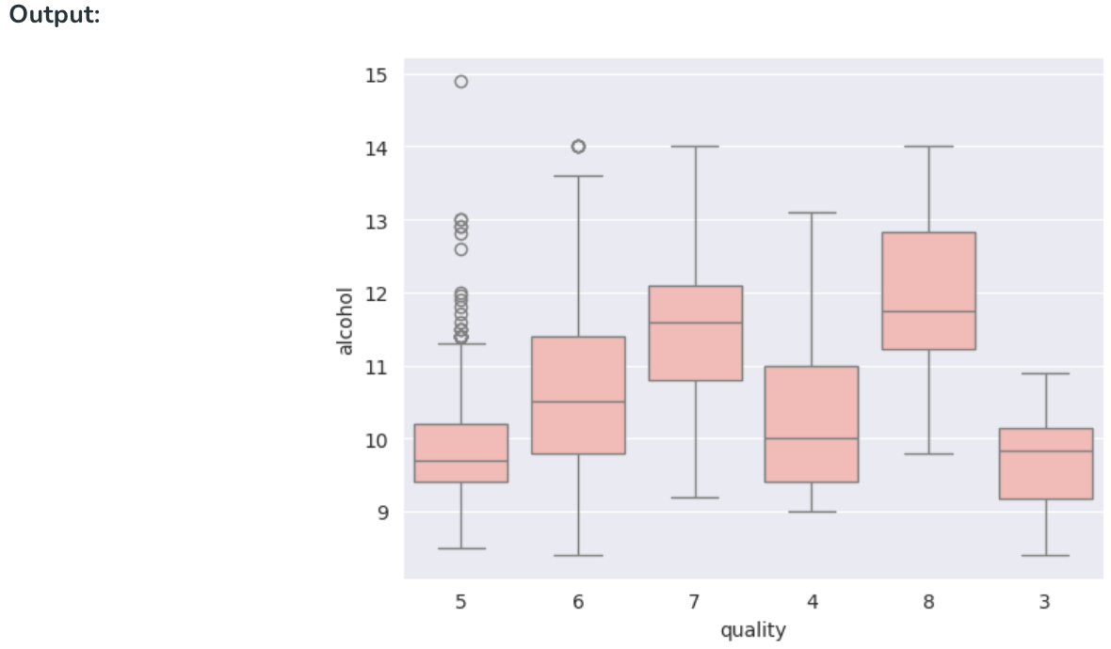
Key Steps for Exploratory Data Analysis (continued)
Step 7: Bivariate Analysis
3. Box Plot for examining the relationship between alcohol and Quality
Notes:
Content:
Not every GenAI idea is worth pursuing immediately. Use a 3-factor model:
🔢 1. ROI (Return on Investment)
Time saved per sprint
Reduction in delivery delays or defects
Value of insight gained
🧩 2. Complexity
Data requirements and integration effort
Workflow disruption and training needs
Tool/vendor dependency
✅ 3. Feasibility
Team maturity and skills
Existing tool compatibility
Governance and AI policy readiness
Use This Matrix:
Quick Wins – High ROI, low complexity (start here)
Strategic Bets – High ROI, high complexity (plan for scale)
Deprioritized – Low ROI, high complexity (low leverage)
Example Exercise:
Score the "automated release note generator":
ROI = High
Complexity = Medium
Feasibility = High
→ Prioritize for pilot

Slide 43
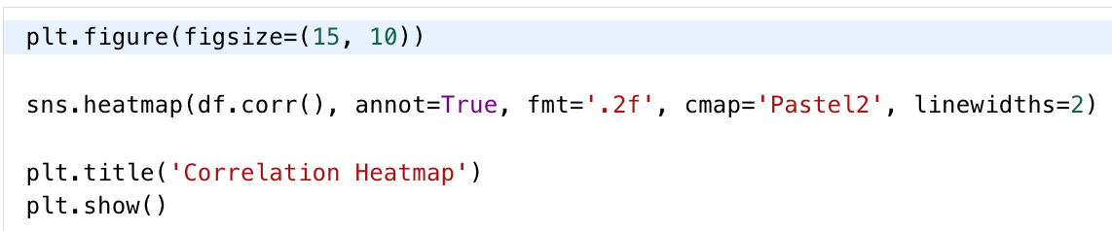
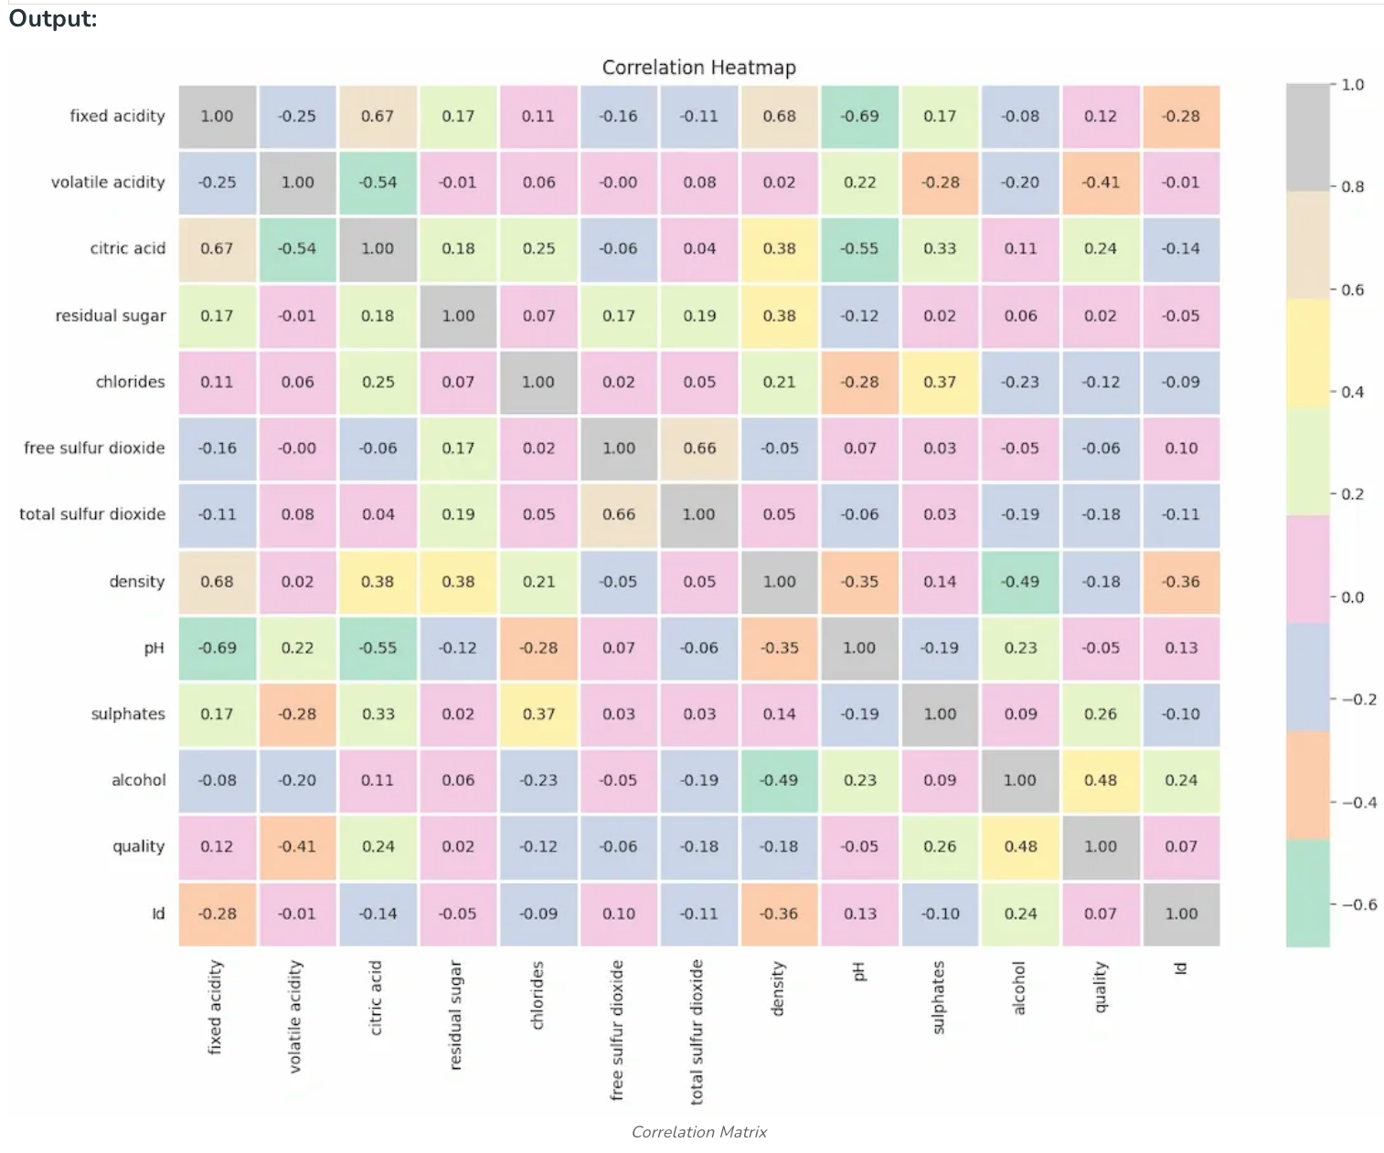
Key Steps for Exploratory Data Analysis (continued)
Step 8: Multivariate Analysis
It involves finding the interactions between three or more variables in a dataset at the same time. This approach focuses to identify complex patterns, relationships and interactions which provides understanding of how multiple variables collectively behave and influence each other. Here, we are going to show the multivariate analysis using a correlation matrix plot.
Notes:
Content:
Not every GenAI idea is worth pursuing immediately. Use a 3-factor model:
🔢 1. ROI (Return on Investment)
Time saved per sprint
Reduction in delivery delays or defects
Value of insight gained
🧩 2. Complexity
Data requirements and integration effort
Workflow disruption and training needs
Tool/vendor dependency
✅ 3. Feasibility
Team maturity and skills
Existing tool compatibility
Governance and AI policy readiness
Use This Matrix:
Quick Wins – High ROI, low complexity (start here)
Strategic Bets – High ROI, high complexity (plan for scale)
Deprioritized – Low ROI, high complexity (low leverage)
Example Exercise:
Score the "automated release note generator":
ROI = High
Complexity = Medium
Feasibility = High
→ Prioritize for pilot

Slide 44
Introduction to AI & Machine Learning Fundamentals
Data, Preprocessing, and Exploratory Data Analysis (EDA)
Python for Machine Learning
Regression – Simple Linear Regression
AGENDA

Slide 45
Why environment setup matters
Reproducibility
Isolation
Pin packages, share environments, avoid "works on my machine"
Separate projects, avoid dependency conflicts
Productivity
Prebuilt data-science packages, easy management (conda)
Notes:
Content:
Not every GenAI idea is worth pursuing immediately. Use a 3-factor model:
🔢 1. ROI (Return on Investment)
Time saved per sprint
Reduction in delivery delays or defects
Value of insight gained
🧩 2. Complexity
Data requirements and integration effort
Workflow disruption and training needs
Tool/vendor dependency
✅ 3. Feasibility
Team maturity and skills
Existing tool compatibility
Governance and AI policy readiness
Use This Matrix:
Quick Wins – High ROI, low complexity (start here)
Strategic Bets – High ROI, high complexity (plan for scale)
Deprioritized – Low ROI, high complexity (low leverage)
Example Exercise:
Score the "automated release note generator":
ROI = High
Complexity = Medium
Feasibility = High
→ Prioritize for pilot

Slide 46


Working with Anaconda
Anaconda is a platform for data scientists, IT professionals, and business leaders of tomorrow. It features more than 300 packages for data science.
Kernels, Data Sources, & Compute Integrations
Anaconda Enterprise automates your organization’s AI pipelines from laptops to training clusters to production clusters with ease
Notes:
Content:
Not every GenAI idea is worth pursuing immediately. Use a 3-factor model:
🔢 1. ROI (Return on Investment)
Time saved per sprint
Reduction in delivery delays or defects
Value of insight gained
🧩 2. Complexity
Data requirements and integration effort
Workflow disruption and training needs
Tool/vendor dependency
✅ 3. Feasibility
Team maturity and skills
Existing tool compatibility
Governance and AI policy readiness
Use This Matrix:
Quick Wins – High ROI, low complexity (start here)
Strategic Bets – High ROI, high complexity (plan for scale)
Deprioritized – Low ROI, high complexity (low leverage)
Example Exercise:
Score the "automated release note generator":
ROI = High
Complexity = Medium
Feasibility = High
→ Prioritize for pilot

Slide 47
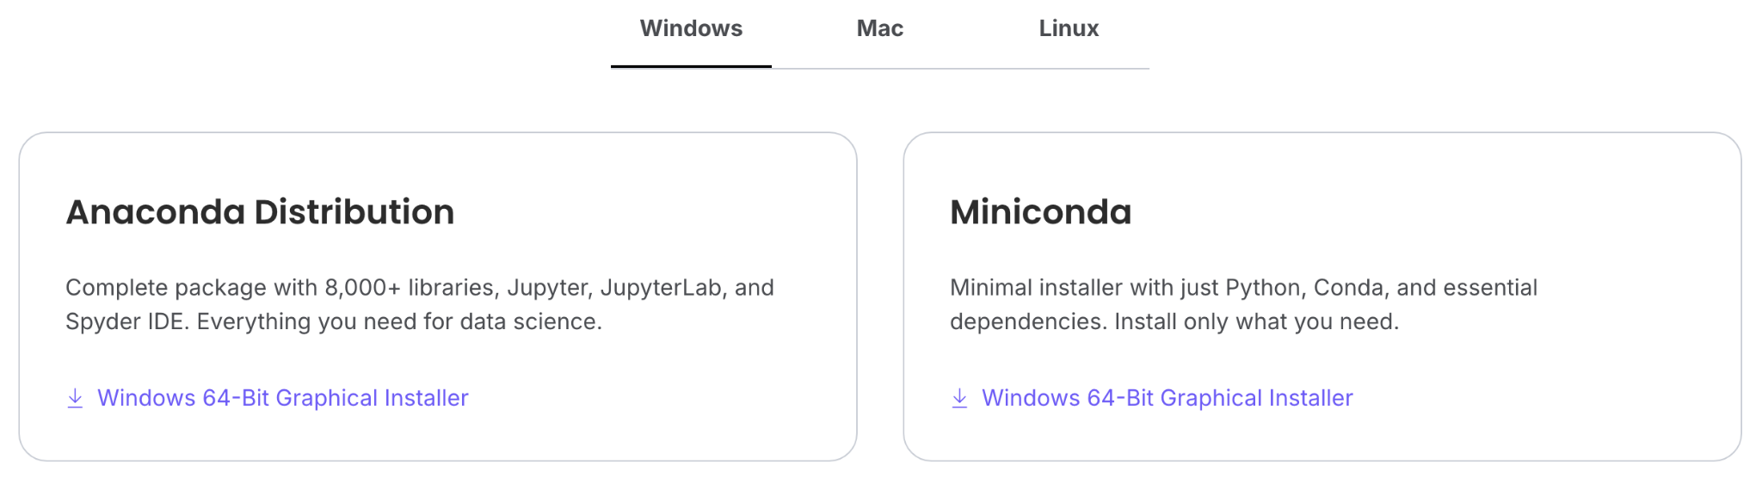
Working with Anaconda
Visit https://www.anaconda.com/distribution/
Choose the correct version and download the Anaconda platform
Notes:
Content:
Not every GenAI idea is worth pursuing immediately. Use a 3-factor model:
🔢 1. ROI (Return on Investment)
Time saved per sprint
Reduction in delivery delays or defects
Value of insight gained
🧩 2. Complexity
Data requirements and integration effort
Workflow disruption and training needs
Tool/vendor dependency
✅ 3. Feasibility
Team maturity and skills
Existing tool compatibility
Governance and AI policy readiness
Use This Matrix:
Quick Wins – High ROI, low complexity (start here)
Strategic Bets – High ROI, high complexity (plan for scale)
Deprioritized – Low ROI, high complexity (low leverage)
Example Exercise:
Score the "automated release note generator":
ROI = High
Complexity = Medium
Feasibility = High
→ Prioritize for pilot

Slide 48
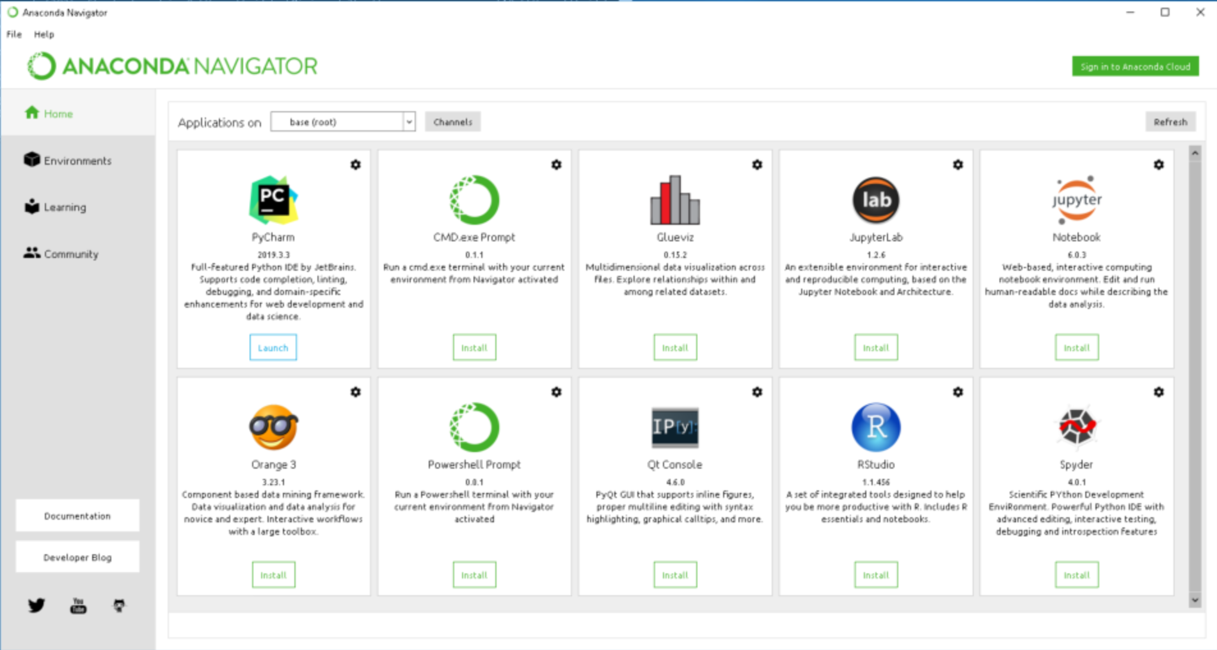
Working with Anaconda
Notes:
Content:
Not every GenAI idea is worth pursuing immediately. Use a 3-factor model:
🔢 1. ROI (Return on Investment)
Time saved per sprint
Reduction in delivery delays or defects
Value of insight gained
🧩 2. Complexity
Data requirements and integration effort
Workflow disruption and training needs
Tool/vendor dependency
✅ 3. Feasibility
Team maturity and skills
Existing tool compatibility
Governance and AI policy readiness
Use This Matrix:
Quick Wins – High ROI, low complexity (start here)
Strategic Bets – High ROI, high complexity (plan for scale)
Deprioritized – Low ROI, high complexity (low leverage)
Example Exercise:
Score the "automated release note generator":
ROI = High
Complexity = Medium
Feasibility = High
→ Prioritize for pilot

Slide 49
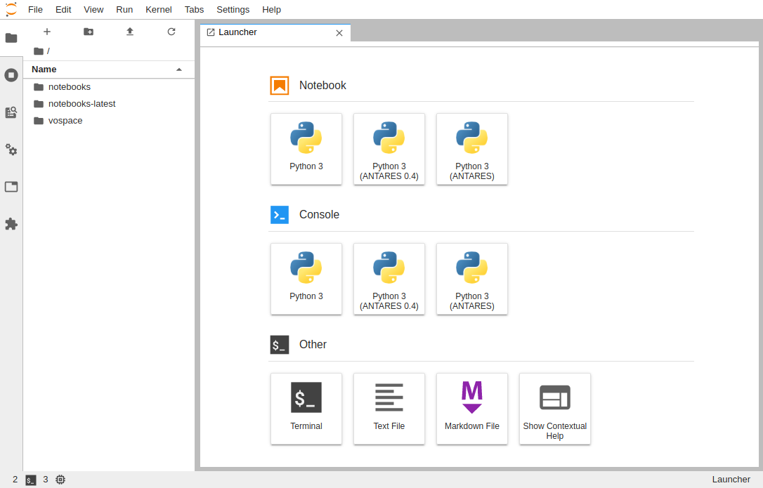
Walking through of JupyterLab Environment
JupyterLab Menu Bar
Jupyter Notebook
For interactive IDE experience
JupyterLab Options
Various options for integrating Jupyter Environment and managing kernels, tasks, & files
Jupyter Console
For Interactive CLI experience
Create New File
Create New Folder
Upload Folder/File
Notes:
Content:
Not every GenAI idea is worth pursuing immediately. Use a 3-factor model:
🔢 1. ROI (Return on Investment)
Time saved per sprint
Reduction in delivery delays or defects
Value of insight gained
🧩 2. Complexity
Data requirements and integration effort
Workflow disruption and training needs
Tool/vendor dependency
✅ 3. Feasibility
Team maturity and skills
Existing tool compatibility
Governance and AI policy readiness
Use This Matrix:
Quick Wins – High ROI, low complexity (start here)
Strategic Bets – High ROI, high complexity (plan for scale)
Deprioritized – Low ROI, high complexity (low leverage)
Example Exercise:
Score the "automated release note generator":
ROI = High
Complexity = Medium
Feasibility = High
→ Prioritize for pilot

Slide 50
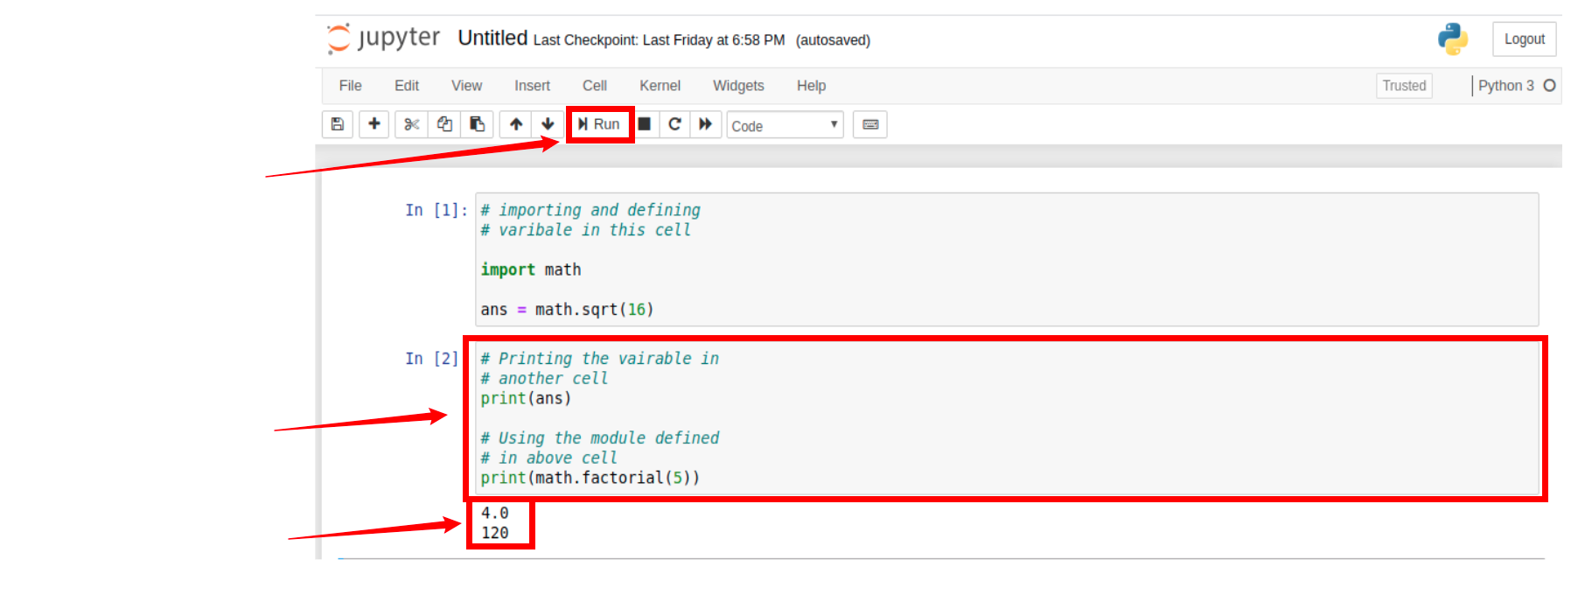
Notebook workflow & running experiments
Run cells sequentially
You can also run cells using Shift + Enter.
Separate cells
Instant outputs
Notes:
Content:
Not every GenAI idea is worth pursuing immediately. Use a 3-factor model:
🔢 1. ROI (Return on Investment)
Time saved per sprint
Reduction in delivery delays or defects
Value of insight gained
🧩 2. Complexity
Data requirements and integration effort
Workflow disruption and training needs
Tool/vendor dependency
✅ 3. Feasibility
Team maturity and skills
Existing tool compatibility
Governance and AI policy readiness
Use This Matrix:
Quick Wins – High ROI, low complexity (start here)
Strategic Bets – High ROI, high complexity (plan for scale)
Deprioritized – Low ROI, high complexity (low leverage)
Example Exercise:
Score the "automated release note generator":
ROI = High
Complexity = Medium
Feasibility = High
→ Prioritize for pilot

Slide 51
Notebook workflow & running experiments
Iterate quickly
Small cells → test code snippets, view outputs instantly
Document experiments
Combine code, markdown, visuals, and results in one file
Share & reproduce
Export .ipynb or convert to HTML; include environment file
Workflow example: Load data → Preprocess → Train → Evaluate → Log results
Notes:
Content:
Not every GenAI idea is worth pursuing immediately. Use a 3-factor model:
🔢 1. ROI (Return on Investment)
Time saved per sprint
Reduction in delivery delays or defects
Value of insight gained
🧩 2. Complexity
Data requirements and integration effort
Workflow disruption and training needs
Tool/vendor dependency
✅ 3. Feasibility
Team maturity and skills
Existing tool compatibility
Governance and AI policy readiness
Use This Matrix:
Quick Wins – High ROI, low complexity (start here)
Strategic Bets – High ROI, high complexity (plan for scale)
Deprioritized – Low ROI, high complexity (low leverage)
Example Exercise:
Score the "automated release note generator":
ROI = High
Complexity = Medium
Feasibility = High
→ Prioritize for pilot

Slide 52
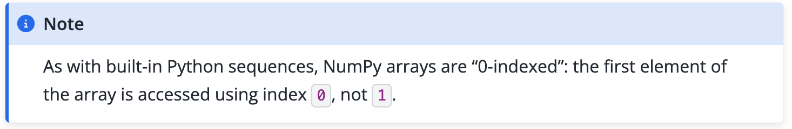
NumPy Basics
ndarray
Homogeneous N‑dimensional array — fast storage & access
Slicing & shapes
Reshape, transpose, index subsets efficiently
Vectorised ops
Element-wise math, broadcasting — avoids Python loops
Notes:
Content:
Not every GenAI idea is worth pursuing immediately. Use a 3-factor model:
🔢 1. ROI (Return on Investment)
Time saved per sprint
Reduction in delivery delays or defects
Value of insight gained
🧩 2. Complexity
Data requirements and integration effort
Workflow disruption and training needs
Tool/vendor dependency
✅ 3. Feasibility
Team maturity and skills
Existing tool compatibility
Governance and AI policy readiness
Use This Matrix:
Quick Wins – High ROI, low complexity (start here)
Strategic Bets – High ROI, high complexity (plan for scale)
Deprioritized – Low ROI, high complexity (low leverage)
Example Exercise:
Score the "automated release note generator":
ROI = High
Complexity = Medium
Feasibility = High
→ Prioritize for pilot

Slide 53
NumPy — quick examples
Array creation
Operations
Slicing
a + b • a * 2
• broadcasting
arr[0:3] • arr[:,1]
• reshape
np.array([1,2,3])
• np.arange(0,10)
NumPy underpins libraries like pandas, scikit‑learn, and TensorFlow
Notes:
Content:
Not every GenAI idea is worth pursuing immediately. Use a 3-factor model:
🔢 1. ROI (Return on Investment)
Time saved per sprint
Reduction in delivery delays or defects
Value of insight gained
🧩 2. Complexity
Data requirements and integration effort
Workflow disruption and training needs
Tool/vendor dependency
✅ 3. Feasibility
Team maturity and skills
Existing tool compatibility
Governance and AI policy readiness
Use This Matrix:
Quick Wins – High ROI, low complexity (start here)
Strategic Bets – High ROI, high complexity (plan for scale)
Deprioritized – Low ROI, high complexity (low leverage)
Example Exercise:
Score the "automated release note generator":
ROI = High
Complexity = Medium
Feasibility = High
→ Prioritize for pilot

Slide 54
Pandas basics
DataFrame
Tabular data structure — labelled rows & columns
Exploration
df.describe(), df.info(), missing value checks
Filtering
Boolean masks: df[df.col > x], chaining conditions
Notes:
Content:
Not every GenAI idea is worth pursuing immediately. Use a 3-factor model:
🔢 1. ROI (Return on Investment)
Time saved per sprint
Reduction in delivery delays or defects
Value of insight gained
🧩 2. Complexity
Data requirements and integration effort
Workflow disruption and training needs
Tool/vendor dependency
✅ 3. Feasibility
Team maturity and skills
Existing tool compatibility
Governance and AI policy readiness
Use This Matrix:
Quick Wins – High ROI, low complexity (start here)
Strategic Bets – High ROI, high complexity (plan for scale)
Deprioritized – Low ROI, high complexity (low leverage)
Example Exercise:
Score the "automated release note generator":
ROI = High
Complexity = Medium
Feasibility = High
→ Prioritize for pilot

Slide 55

Reading CSVs & preparing features
Load
df = pd.read_csv('data.csv')
Clean
Handle NaNs, type conversion, drop duplicates
Features
Encode categoricals, scale numerics, create derived cols
Save prepared features: df.to_csv('features.csv', index=False)
Notes:
Content:
Not every GenAI idea is worth pursuing immediately. Use a 3-factor model:
🔢 1. ROI (Return on Investment)
Time saved per sprint
Reduction in delivery delays or defects
Value of insight gained
🧩 2. Complexity
Data requirements and integration effort
Workflow disruption and training needs
Tool/vendor dependency
✅ 3. Feasibility
Team maturity and skills
Existing tool compatibility
Governance and AI policy readiness
Use This Matrix:
Quick Wins – High ROI, low complexity (start here)
Strategic Bets – High ROI, high complexity (plan for scale)
Deprioritized – Low ROI, high complexity (low leverage)
Example Exercise:
Score the "automated release note generator":
ROI = High
Complexity = Medium
Feasibility = High
→ Prioritize for pilot

Slide 56
Introduction to AI & Machine Learning Fundamentals
Data, Preprocessing, and Exploratory Data Analysis (EDA)
Python for Machine Learning
Regression – Simple Linear Regression
AGENDA

Slide 57
Regression based Algorithms
Generalized Linear Models
Linear
Lasso
Logistic
Multivariate
Multiple
Salary forecasting
Traffic forecasting
Enterprise wide risk framework
Analyze multiple stress scenarios
Predict House Prices
Customer Lifetime value
Best product combinations for retailers
Behavioural Analysis
Insurance Claim Worthiness

Slide 58
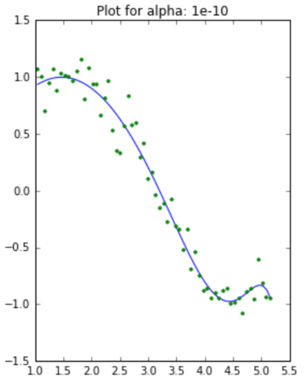
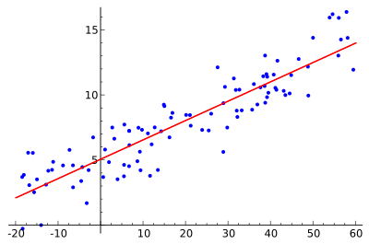
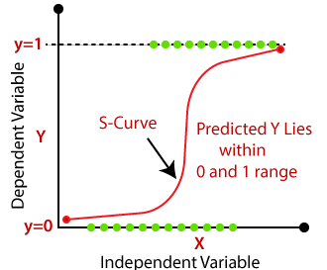
Regression based Algorithms
Linear
Lasso
Logistic

Slide 59
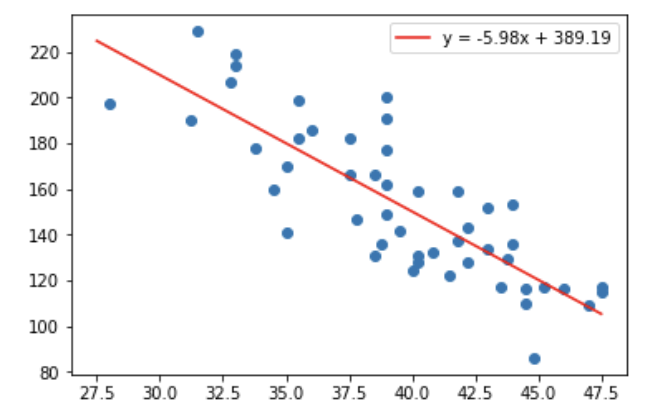
Our first algorithm: Linear Regression
Relates your input (sometimes called "independent variable") to your output ("dependent variable") by fitting a straight line through your data
Notes:
Content:
Not every GenAI idea is worth pursuing immediately. Use a 3-factor model:
🔢 1. ROI (Return on Investment)
Time saved per sprint
Reduction in delivery delays or defects
Value of insight gained
🧩 2. Complexity
Data requirements and integration effort
Workflow disruption and training needs
Tool/vendor dependency
✅ 3. Feasibility
Team maturity and skills
Existing tool compatibility
Governance and AI policy readiness
Use This Matrix:
Quick Wins – High ROI, low complexity (start here)
Strategic Bets – High ROI, high complexity (plan for scale)
Deprioritized – Low ROI, high complexity (low leverage)
Example Exercise:
Score the "automated release note generator":
ROI = High
Complexity = Medium
Feasibility = High
→ Prioritize for pilot

Slide 60
Our first algorithm: Linear Regression (cont’d)
Can be expressed using a simple formula that will take you back to elementary school: y = mx + b
In two dimensions x, y, m, and b are all single numbers
In multidimensional problems not much changes, we
simply add more m's and x's — one for each feature in
the training data: y = m₁x₁ + m₂x₂ + m₃x₃ ... m_{n}x_{n} + b
Note that we still have only a single "intercept" but
one coefficient (m) per input feature (x)
Notes:
Content:
Not every GenAI idea is worth pursuing immediately. Use a 3-factor model:
🔢 1. ROI (Return on Investment)
Time saved per sprint
Reduction in delivery delays or defects
Value of insight gained
🧩 2. Complexity
Data requirements and integration effort
Workflow disruption and training needs
Tool/vendor dependency
✅ 3. Feasibility
Team maturity and skills
Existing tool compatibility
Governance and AI policy readiness
Use This Matrix:
Quick Wins – High ROI, low complexity (start here)
Strategic Bets – High ROI, high complexity (plan for scale)
Deprioritized – Low ROI, high complexity (low leverage)
Example Exercise:
Score the "automated release note generator":
ROI = High
Complexity = Medium
Feasibility = High
→ Prioritize for pilot

Slide 61
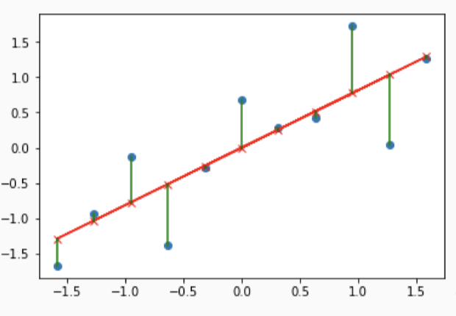
Our first algorithm: Linear Regression (cont’d)
Works by minimizing the sum of squared errors (technically called residuals) between the data points and the regression line
Notes:
Content:
Not every GenAI idea is worth pursuing immediately. Use a 3-factor model:
🔢 1. ROI (Return on Investment)
Time saved per sprint
Reduction in delivery delays or defects
Value of insight gained
🧩 2. Complexity
Data requirements and integration effort
Workflow disruption and training needs
Tool/vendor dependency
✅ 3. Feasibility
Team maturity and skills
Existing tool compatibility
Governance and AI policy readiness
Use This Matrix:
Quick Wins – High ROI, low complexity (start here)
Strategic Bets – High ROI, high complexity (plan for scale)
Deprioritized – Low ROI, high complexity (low leverage)
Example Exercise:
Score the "automated release note generator":
ROI = High
Complexity = Medium
Feasibility = High
→ Prioritize for pilot

Slide 62
Linear Regression: Pros and Cons
Pros
  Common approach for numeric data
  Easily interpretable
  Estimates strength and size of relationships among
  features and targets
Cons
  Strong assumptions about the data (i.e., linearity)
  Sensitive to outliers
Notes:
Content:
Not every GenAI idea is worth pursuing immediately. Use a 3-factor model:
🔢 1. ROI (Return on Investment)
Time saved per sprint
Reduction in delivery delays or defects
Value of insight gained
🧩 2. Complexity
Data requirements and integration effort
Workflow disruption and training needs
Tool/vendor dependency
✅ 3. Feasibility
Team maturity and skills
Existing tool compatibility
Governance and AI policy readiness
Use This Matrix:
Quick Wins – High ROI, low complexity (start here)
Strategic Bets – High ROI, high complexity (plan for scale)
Deprioritized – Low ROI, high complexity (low leverage)
Example Exercise:
Score the "automated release note generator":
ROI = High
Complexity = Medium
Feasibility = High
→ Prioritize for pilot

Slide 63
Covariance
Measure of joint variability
  i.e., how does one variable change as the other changes?
  this draws our attention to a connection
Non-zero covariance implies?
  there is some connection
Zero covariance implies?
  Independence
“Correlation is not causation”
–Anyone who has ever taken statistics
Correlation is not causation, but it sure is a hint”
Notes:
Content:
Not every GenAI idea is worth pursuing immediately. Use a 3-factor model:
🔢 1. ROI (Return on Investment)
Time saved per sprint
Reduction in delivery delays or defects
Value of insight gained
🧩 2. Complexity
Data requirements and integration effort
Workflow disruption and training needs
Tool/vendor dependency
✅ 3. Feasibility
Team maturity and skills
Existing tool compatibility
Governance and AI policy readiness
Use This Matrix:
Quick Wins – High ROI, low complexity (start here)
Strategic Bets – High ROI, high complexity (plan for scale)
Deprioritized – Low ROI, high complexity (low leverage)
Example Exercise:
Score the "automated release note generator":
ROI = High
Complexity = Medium
Feasibility = High
→ Prioritize for pilot

Slide 64
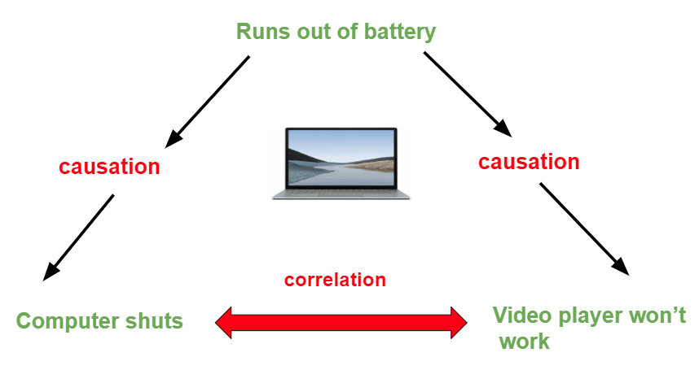
Correlation/Causation
What are the possible causal relationships?
  could be unrelated, i.e., coincidence
  reverse causation
    every time windmills are spinning it's really windy
missed variable, i.e., some other factor causes both
  whenever I go to sleep with my shoes on I wake up with a headache when it rains, every time I see a flash I hear a boom
bi-directional relationships: temperature and pressure
or they are actually the same thing: ºF goes up as ºC goes up
Notes:
Content:
Not every GenAI idea is worth pursuing immediately. Use a 3-factor model:
🔢 1. ROI (Return on Investment)
Time saved per sprint
Reduction in delivery delays or defects
Value of insight gained
🧩 2. Complexity
Data requirements and integration effort
Workflow disruption and training needs
Tool/vendor dependency
✅ 3. Feasibility
Team maturity and skills
Existing tool compatibility
Governance and AI policy readiness
Use This Matrix:
Quick Wins – High ROI, low complexity (start here)
Strategic Bets – High ROI, high complexity (plan for scale)
Deprioritized – Low ROI, high complexity (low leverage)
Example Exercise:
Score the "automated release note generator":
ROI = High
Complexity = Medium
Feasibility = High
→ Prioritize for pilot

Slide 65
Choosing an ML Algorithm
Now that we’ve seen a few (and there are MANY more), how do we know what to choose?
from an exploratory data analysis standpoint, we might try
things and see what works
but if we can't map it back to the business function, it
doesn't matter
if it does work, but doesn't work from an operational
standpoint, you can't use it either
  e.g., can't run on a phone, or breaks email
therefore, not everything that works is available to us
sometimes things work well in one domain but don't
work well in another … in ML we say:
“THERE IS NO FREE LUNCH!”
Notes:
Content:
Not every GenAI idea is worth pursuing immediately. Use a 3-factor model:
🔢 1. ROI (Return on Investment)
Time saved per sprint
Reduction in delivery delays or defects
Value of insight gained
🧩 2. Complexity
Data requirements and integration effort
Workflow disruption and training needs
Tool/vendor dependency
✅ 3. Feasibility
Team maturity and skills
Existing tool compatibility
Governance and AI policy readiness
Use This Matrix:
Quick Wins – High ROI, low complexity (start here)
Strategic Bets – High ROI, high complexity (plan for scale)
Deprioritized – Low ROI, high complexity (low leverage)
Example Exercise:
Score the "automated release note generator":
ROI = High
Complexity = Medium
Feasibility = High
→ Prioritize for pilot

Slide 66
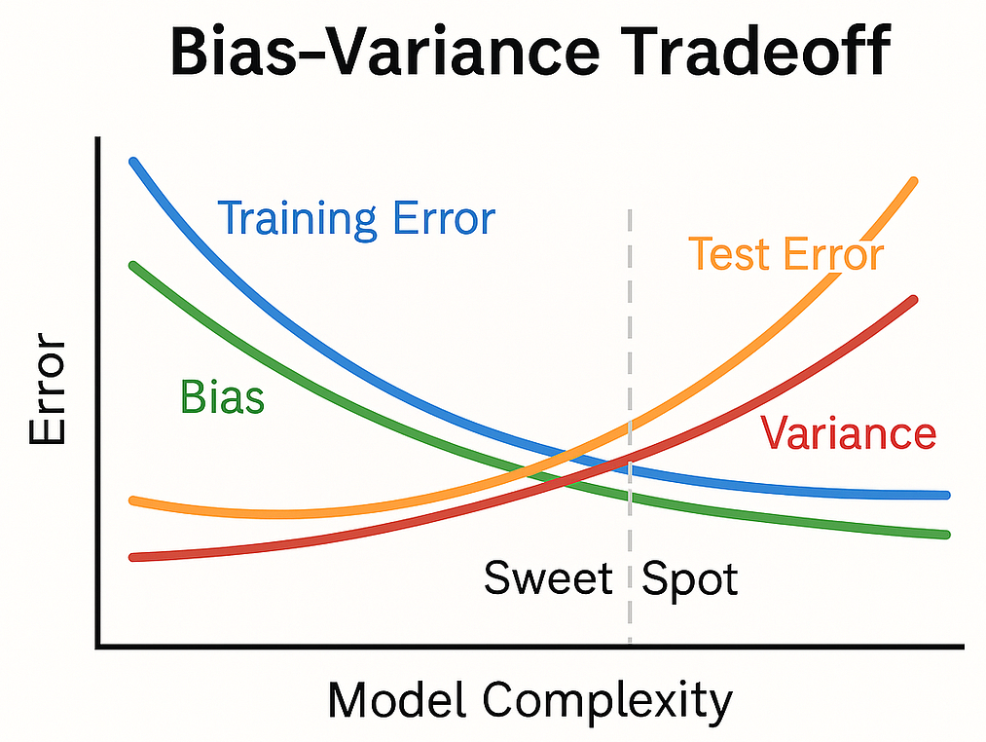
Bias/Variance Tradeoff
A model is the "function" which is produced from an ML algorithm
bias refers to errors made when our model is too simple–i.e., it doesn’t consider enough features
high bias means our model is making errors because it doesn’t
know enough...also called underfitting
  Credit scoring...what if we consider only income?
variance refers to poor generalization to new, unseen data
  Our model knows too much or we are feeding it too many features–some of them aren’t predictive of the target in general
  ...also called overfitting
Goldilocks once again
  As we add more features, bias decreases, but when we add too many, variance increases
Notes:
Content:
Not every GenAI idea is worth pursuing immediately. Use a 3-factor model:
🔢 1. ROI (Return on Investment)
Time saved per sprint
Reduction in delivery delays or defects
Value of insight gained
🧩 2. Complexity
Data requirements and integration effort
Workflow disruption and training needs
Tool/vendor dependency
✅ 3. Feasibility
Team maturity and skills
Existing tool compatibility
Governance and AI policy readiness
Use This Matrix:
Quick Wins – High ROI, low complexity (start here)
Strategic Bets – High ROI, high complexity (plan for scale)
Deprioritized – Low ROI, high complexity (low leverage)
Example Exercise:
Score the "automated release note generator":
ROI = High
Complexity = Medium
Feasibility = High
→ Prioritize for pilot

Slide 67
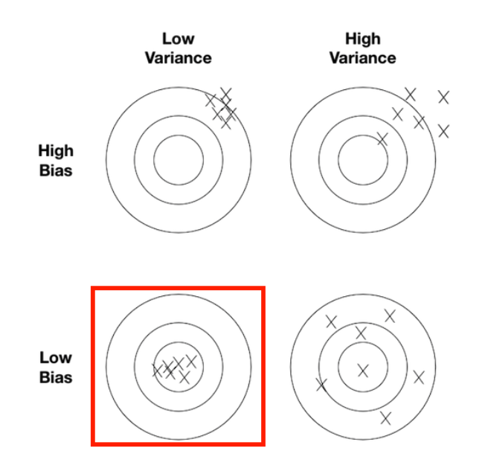
Bias/Variance Tradeoff (cont’d)
Lower left: where we’d like to be...training data reflects the population we are trying to predict, good selection of features, good choice of algorithm, etc.
Upper left: underfit...we’re consistently wrong (our model is too simple)
Lower right: overfit, we do well on our test data, but we’ll generalize poorly to new data
Upper right: good algorithms +
bad data = garbage
...imagine building a model of credit worthiness based on favorite color
Notes:
Content:
Not every GenAI idea is worth pursuing immediately. Use a 3-factor model:
🔢 1. ROI (Return on Investment)
Time saved per sprint
Reduction in delivery delays or defects
Value of insight gained
🧩 2. Complexity
Data requirements and integration effort
Workflow disruption and training needs
Tool/vendor dependency
✅ 3. Feasibility
Team maturity and skills
Existing tool compatibility
Governance and AI policy readiness
Use This Matrix:
Quick Wins – High ROI, low complexity (start here)
Strategic Bets – High ROI, high complexity (plan for scale)
Deprioritized – Low ROI, high complexity (low leverage)
Example Exercise:
Score the "automated release note generator":
ROI = High
Complexity = Medium
Feasibility = High
→ Prioritize for pilot

Slide 68
Feature Selection
Given that features can make or break our model, we need to be thoughtful about which features to include (or exclude)
Too many/few features result in overfitting/underfitting
We’ve seen some scatterplots where we are able to identify the features which are predictive of our target–that’s a
good place to start
  Discard features that aren’t predictive of the target
  Our intuition is often bad–look at the data!
Be careful of correlations between features, which is
known as multicollinearity–we typically would discard
a feature which is highly correlated with another
Notes:
Content:
Not every GenAI idea is worth pursuing immediately. Use a 3-factor model:
🔢 1. ROI (Return on Investment)
Time saved per sprint
Reduction in delivery delays or defects
Value of insight gained
🧩 2. Complexity
Data requirements and integration effort
Workflow disruption and training needs
Tool/vendor dependency
✅ 3. Feasibility
Team maturity and skills
Existing tool compatibility
Governance and AI policy readiness
Use This Matrix:
Quick Wins – High ROI, low complexity (start here)
Strategic Bets – High ROI, high complexity (plan for scale)
Deprioritized – Low ROI, high complexity (low leverage)
Example Exercise:
Score the "automated release note generator":
ROI = High
Complexity = Medium
Feasibility = High
→ Prioritize for pilot

Slide 69
Curse of Dimensionality
Models which don’t consider “enough” features do not make good predictions (e.g., credit scoring)
  Technically “underfitting”...but hold that thought
Our intuition is that considering more features is always better, but that is not always true
The more features we consider, the more data we need to train our model
In other words, as dimensionality increases, the volume of the space increases and the data become sparse
Notes:
Content:
Not every GenAI idea is worth pursuing immediately. Use a 3-factor model:
🔢 1. ROI (Return on Investment)
Time saved per sprint
Reduction in delivery delays or defects
Value of insight gained
🧩 2. Complexity
Data requirements and integration effort
Workflow disruption and training needs
Tool/vendor dependency
✅ 3. Feasibility
Team maturity and skills
Existing tool compatibility
Governance and AI policy readiness
Use This Matrix:
Quick Wins – High ROI, low complexity (start here)
Strategic Bets – High ROI, high complexity (plan for scale)
Deprioritized – Low ROI, high complexity (low leverage)
Example Exercise:
Score the "automated release note generator":
ROI = High
Complexity = Medium
Feasibility = High
→ Prioritize for pilot

Slide 70
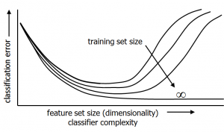
Curse of Dimensionality (cont’d)
Hughes Phenomenon: predictive power of a classifier or regressor increases as number of dimensions/features considered increases, then decreases
Notes:
Content:
Not every GenAI idea is worth pursuing immediately. Use a 3-factor model:
🔢 1. ROI (Return on Investment)
Time saved per sprint
Reduction in delivery delays or defects
Value of insight gained
🧩 2. Complexity
Data requirements and integration effort
Workflow disruption and training needs
Tool/vendor dependency
✅ 3. Feasibility
Team maturity and skills
Existing tool compatibility
Governance and AI policy readiness
Use This Matrix:
Quick Wins – High ROI, low complexity (start here)
Strategic Bets – High ROI, high complexity (plan for scale)
Deprioritized – Low ROI, high complexity (low leverage)
Example Exercise:
Score the "automated release note generator":
ROI = High
Complexity = Medium
Feasibility = High
→ Prioritize for pilot

Slide 71
Curse of Dimensionality (cont’d)
Suppose we have 20 data points, x₁, x₂, …, x₂₀
  e.g., perhaps they are gross revenue for companies that are in the trial phase with our SaaS product
We also have 20 target values, t₁, t₂, …, t₂₀
  red = won’t convert, i.e., won’t pay for our product
  green = converts, i.e., will be a paying customer
We want an ML classifier to tell us the probability of a customer converting, p(t_{n} = g|x_{n})
First cut, we’ll partition x into four equal-sized regions
Notes:
Content:
Not every GenAI idea is worth pursuing immediately. Use a 3-factor model:
🔢 1. ROI (Return on Investment)
Time saved per sprint
Reduction in delivery delays or defects
Value of insight gained
🧩 2. Complexity
Data requirements and integration effort
Workflow disruption and training needs
Tool/vendor dependency
✅ 3. Feasibility
Team maturity and skills
Existing tool compatibility
Governance and AI policy readiness
Use This Matrix:
Quick Wins – High ROI, low complexity (start here)
Strategic Bets – High ROI, high complexity (plan for scale)
Deprioritized – Low ROI, high complexity (low leverage)
Example Exercise:
Score the "automated release note generator":
ROI = High
Complexity = Medium
Feasibility = High
→ Prioritize for pilot

Slide 72
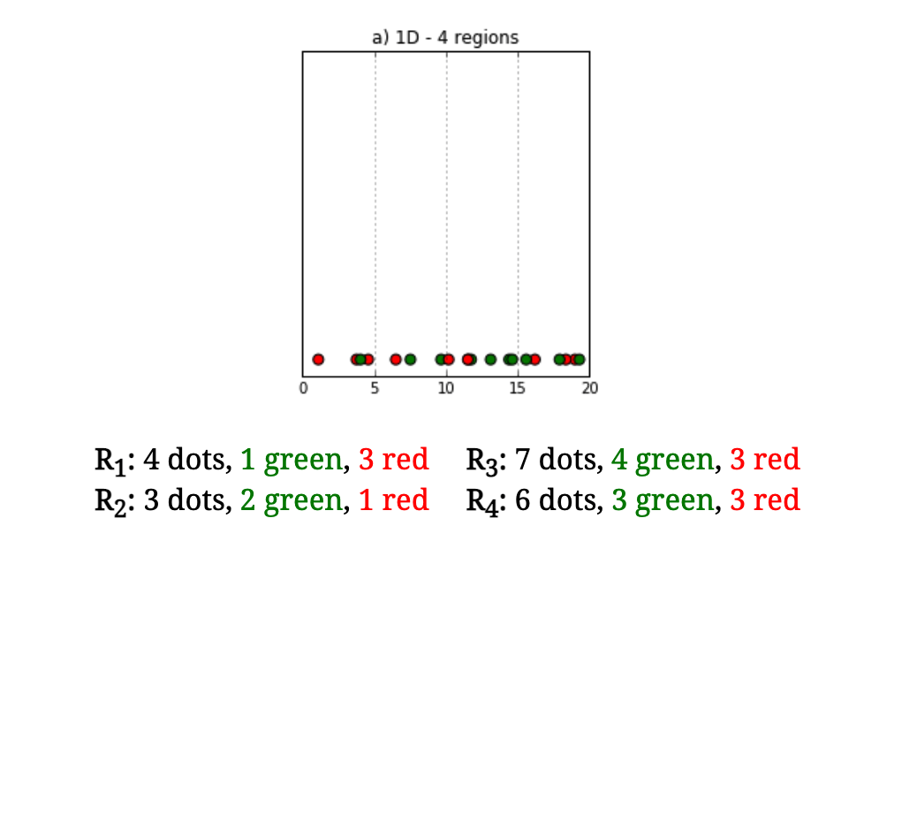
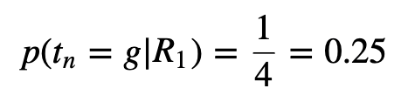
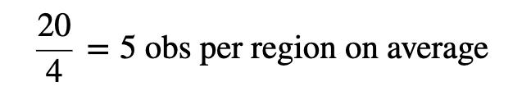
Curse of Dimensionality (cont’d)
Notes:
Content:
Not every GenAI idea is worth pursuing immediately. Use a 3-factor model:
🔢 1. ROI (Return on Investment)
Time saved per sprint
Reduction in delivery delays or defects
Value of insight gained
🧩 2. Complexity
Data requirements and integration effort
Workflow disruption and training needs
Tool/vendor dependency
✅ 3. Feasibility
Team maturity and skills
Existing tool compatibility
Governance and AI policy readiness
Use This Matrix:
Quick Wins – High ROI, low complexity (start here)
Strategic Bets – High ROI, high complexity (plan for scale)
Deprioritized – Low ROI, high complexity (low leverage)
Example Exercise:
Score the "automated release note generator":
ROI = High
Complexity = Medium
Feasibility = High
→ Prioritize for pilot

Slide 73
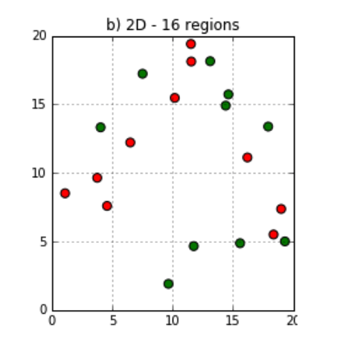
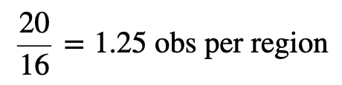
Curse of Dimensionality (cont’d)
Now let’s consider an additional dimension (e.g., # of employees)
Notes:
Content:
Not every GenAI idea is worth pursuing immediately. Use a 3-factor model:
🔢 1. ROI (Return on Investment)
Time saved per sprint
Reduction in delivery delays or defects
Value of insight gained
🧩 2. Complexity
Data requirements and integration effort
Workflow disruption and training needs
Tool/vendor dependency
✅ 3. Feasibility
Team maturity and skills
Existing tool compatibility
Governance and AI policy readiness
Use This Matrix:
Quick Wins – High ROI, low complexity (start here)
Strategic Bets – High ROI, high complexity (plan for scale)
Deprioritized – Low ROI, high complexity (low leverage)
Example Exercise:
Score the "automated release note generator":
ROI = High
Complexity = Medium
Feasibility = High
→ Prioritize for pilot

Slide 74
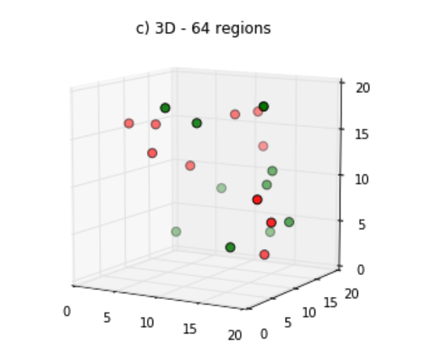


Curse of Dimensionality (cont’d)
Now let’s consider an additional dimension (e.g., years in business)
Notes:
Content:
Not every GenAI idea is worth pursuing immediately. Use a 3-factor model:
🔢 1. ROI (Return on Investment)
Time saved per sprint
Reduction in delivery delays or defects
Value of insight gained
🧩 2. Complexity
Data requirements and integration effort
Workflow disruption and training needs
Tool/vendor dependency
✅ 3. Feasibility
Team maturity and skills
Existing tool compatibility
Governance and AI policy readiness
Use This Matrix:
Quick Wins – High ROI, low complexity (start here)
Strategic Bets – High ROI, high complexity (plan for scale)
Deprioritized – Low ROI, high complexity (low leverage)
Example Exercise:
Score the "automated release note generator":
ROI = High
Complexity = Medium
Feasibility = High
→ Prioritize for pilot

Slide 75
Curse of Dimensionality (cont’d)
As the number of dimensions increases, number of samples we need grows exponentially
We need enough dimensions to have ample variation to detect the classification of each input–too many dimensions requires too much data, two few does not have enough feature variation to detect anything
In addition, considering too many features can lead to “overfitting”–our model learns idiosyncrasies of our training data and does not generalize well
Goldilocks is the answer yet again...
Notes:
Content:
Not every GenAI idea is worth pursuing immediately. Use a 3-factor model:
🔢 1. ROI (Return on Investment)
Time saved per sprint
Reduction in delivery delays or defects
Value of insight gained
🧩 2. Complexity
Data requirements and integration effort
Workflow disruption and training needs
Tool/vendor dependency
✅ 3. Feasibility
Team maturity and skills
Existing tool compatibility
Governance and AI policy readiness
Use This Matrix:
Quick Wins – High ROI, low complexity (start here)
Strategic Bets – High ROI, high complexity (plan for scale)
Deprioritized – Low ROI, high complexity (low leverage)
Example Exercise:
Score the "automated release note generator":
ROI = High
Complexity = Medium
Feasibility = High
→ Prioritize for pilot

Slide 76

ANY
QUESTIONS ?

Slide 77
THANK YOU

